Slide 1
Língua inglesa
CONJUNTO 1
9º ano

Slide 2
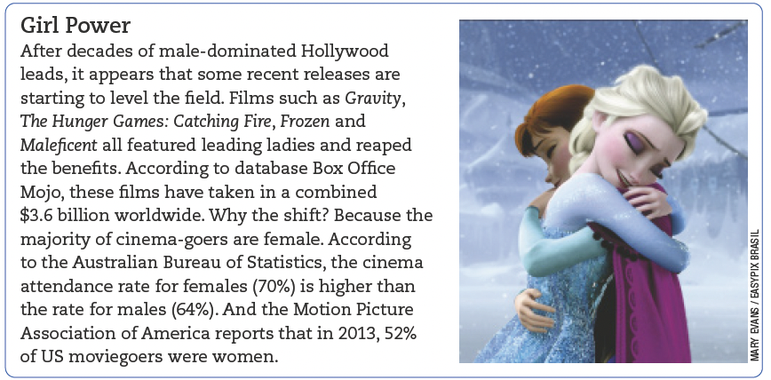
UNIT 8
TIP
Observe a diferença de usos de acordo com a variação linguística do inglês:
movie (AmE)
= film (AuE/BrE);
the movies/movie theater (AmE) = the cinema (AuE/BrE).
READER’S DIGEST, Austrália, vol. 187, n. 1 115, p. 118, jan. 2015.

Slide 3
UNIT 8
I. “Films such as Gravity, The Hunger Games: Catching Fire, Frozen and Maleficent (…)”
II. “According to the Australian Bureau of Statistics (…)”
Linking words/ phrases
SUCH AS
is used to
ACCORDING TO
is used to
introduce examples.
refer to a source.
ACCORDING TO
is equivalente in meaning to
with reference to.

Slide 4
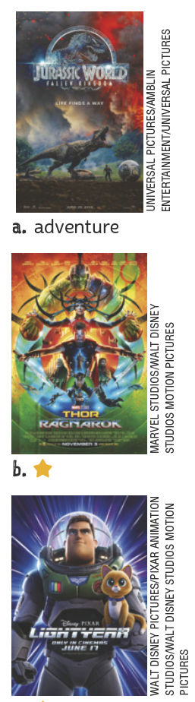
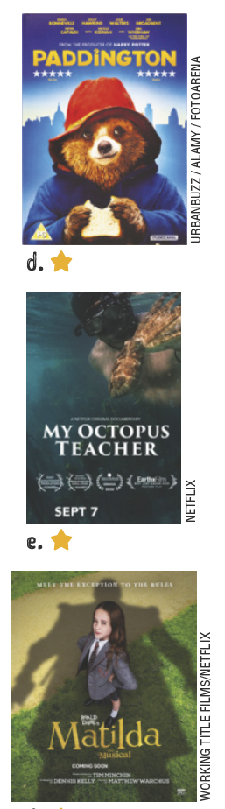
UNIT 8
adventure
comedy
Kinds of movie
action
documentary
animation
drama

Slide 5
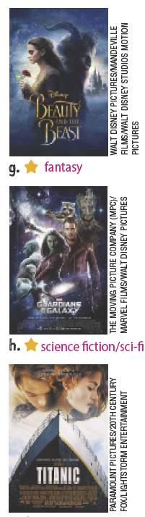

UNIT 8
fantasy
musical
Kinds of movie
science fiction
thriller
romance
western

Slide 6
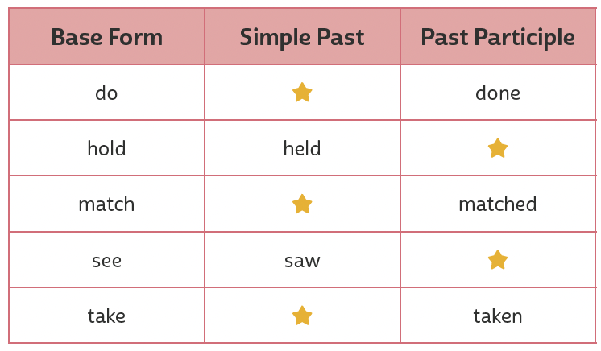
UNIT 8
did
held
matched
Present perfect or simple past?
seen
took
TIP
Consulte o quadro de verbos irregulares ao final do livro sempre que necessário.
Time expressions used with the simple past
yesterday, when I was a child, last month, a year ago
Time expressions used with the present perfect
recently, since I was a child, over the years, lately

