Slide 1
Língua inglesa
CONJUNTO 1
9º ano

Slide 2
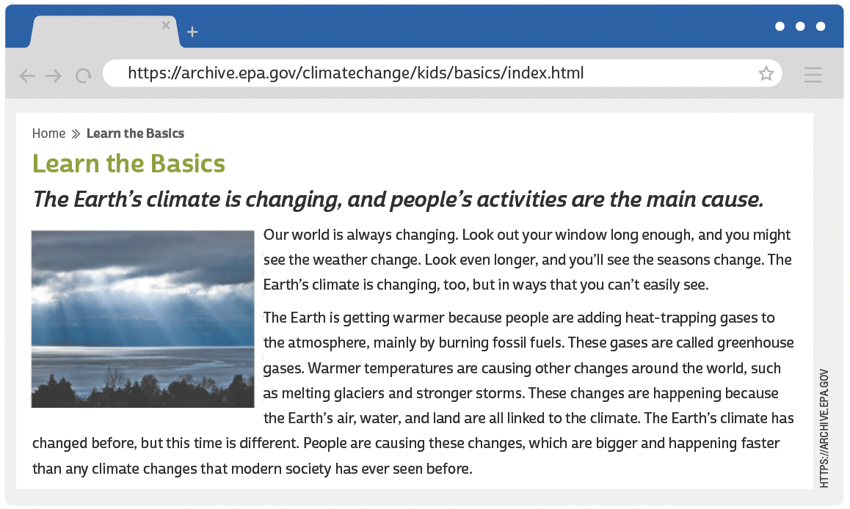
UNIT 7
LANGUAGE NOTE
Weather × Climate
Weather is a specific event or condition that happens over a period of hours or days.
Climate refers to the average weather conditions in a place over many years (usually at least 30 years).
UNITED STATES ENVIRONMENTAL PROTECTION AGENCY. Learn the basics. 5 set. 2017. Disponível em: https://archive.epa.gov/climatechange/kids/basics/index.html. Acesso em: 25 jun. 2022.

Slide 3
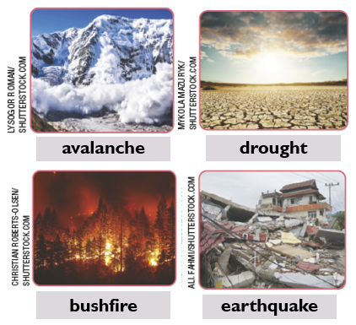
UNIT 7
Natural disasters

Slide 4
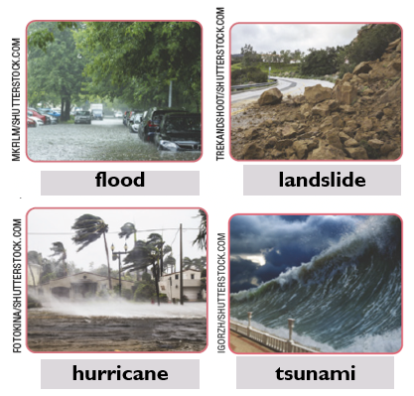
UNIT 7
Natural disasters

Slide 5
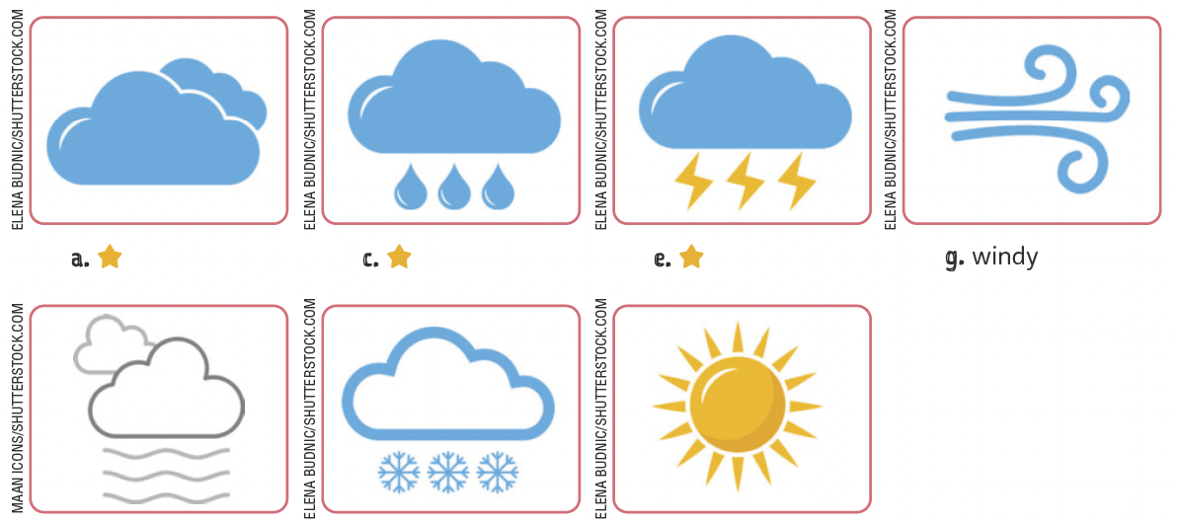
UNIT 7
The weather
cloudy
rainy
stormy
windy
TIP
Em inglês, o sufixo -y
geralmente é acrescentado
a substantivos para formar
adjetivos:
snow ➡️ snowy;
rain ➡️ rainy;
storm ➡️ stormy.
foggy
snowy
sunny

Slide 6
UNIT 7
affected
changed
rise
warned
warned
Present perfect
“The Earth’s climate has changed before (...)”
The structure of the present perfect is
auxiliary verb (have/has) +
“(...) modern society has ever seen before.”
main verb (past participle)
TIP
Consulte o quadro de verbos irregulares ao final do livro sempre que necessário.

