Slide 1
Língua inglesa
CONJUNTO 1
9º ano

Slide 2
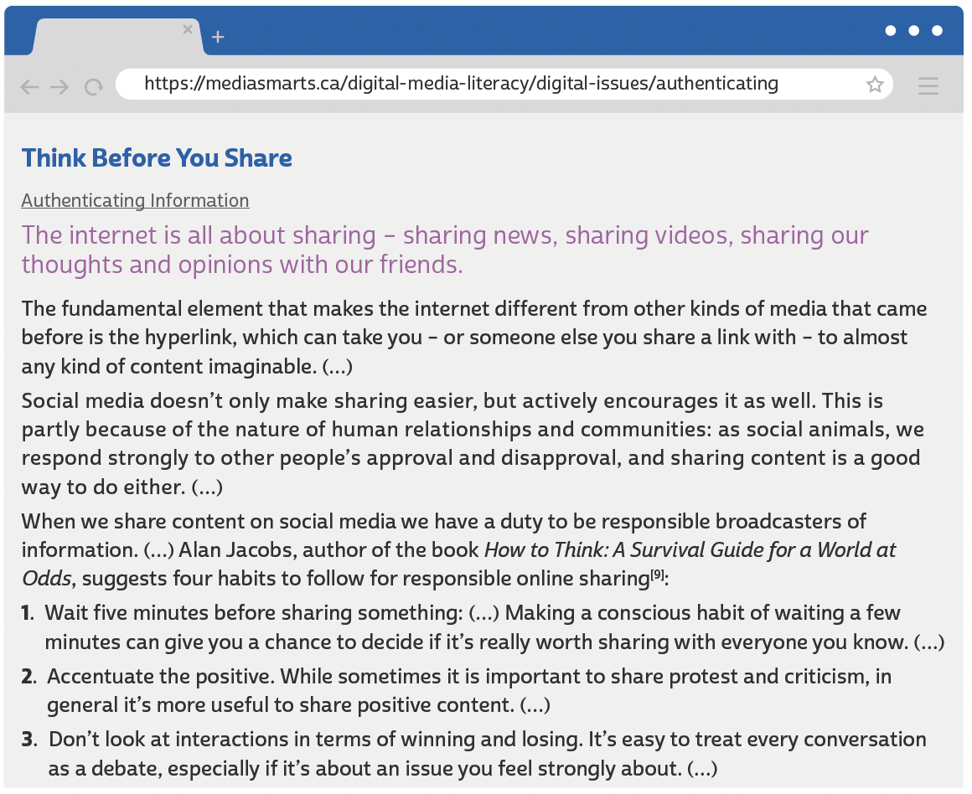
UNIT 1
MEDIA SMARTS. Think before you share. [2022?]. Disponível em: https://mediasmarts.ca/digital-media-literacy/digital-issues/authenticating-information/ethics-sharing-information-online/think-you-share. Acesso em: 6 jul. 2022.

Slide 3
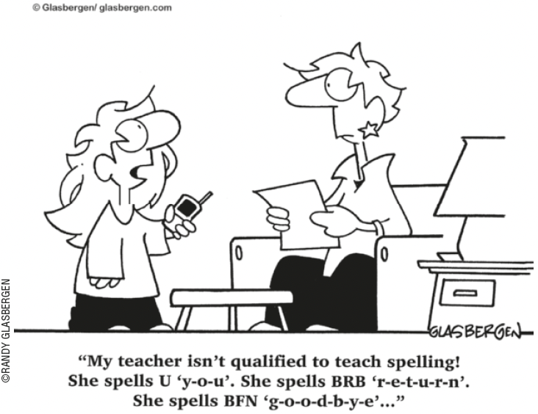
UNIT 1
TIP
Ao ler cartuns, observe as
relações entre os elementos
verbais e os não verbais.
Internet slang
THINK ABOUT IT!
No cartum, por que a menina
diz que sua professora não é qualificada para ensinar a
escrever? Você concorda com
ela? Para a menina, como se deve escrever a palavra “you”?
NSEA.ORG. Língua inglesa. Pinterest, 2022. Disponível em: https://br.pinterest.com/pin/195062227583057030/. Acesso em: 6 jul. 2022.

Slide 4
UNIT 1
2DAY
4EVER
B4
BFF
DM
GR8
ILU
LOL
PLS
TBT
THX/THKS
U2
UR
XOXO
today
forever
before
best friends forever
direct message
great
I love you
laughing out loud
please
throwback Thursday
thanks
you too
your
hugs and kisses
Internet slang

Slide 5
UNIT 1
What to Report
• Anyone you don’t know who asks you for personal information, photos, or videos.
• Inappropriate or obscene material from people or companies you don’t know.
• Misleading URLs on the Internet that point you to sites containing harmful or inappropriate materials rather than what you were looking for.
• Anyone who sends you photos or videos containing obscene content of individuals 18 and younger (the possession, manufacturing, or distributing of child pornography is illegal). (…)
Review: relative pronouns
LANGUAGE NOTE
We use: To refer to:
that people and things
which things
who people
which people and things (possession)
FULTON COUNTY SCHOOLS. FAQ and fact sheet: cyberbullying. 2002-2022. Disponível em: www.fultonschools.org/cms/lib/GA50000114/Centricity/Domain/5419/Cyberbullying%20FAQ%20Fact%20Sheet.pdf. Acesso em: 6 jul. 2022.

Slide 6
UNIT 1
Where and how does your source get its information? A proper article should cite the information and data they are sharing. Investigate their sources for yourself. Does the information line up, was important information left out, or are facts being twisted? If they don’t have a source at all, or it comes from a non-credible source, that should be a red flag.
Modal verbs: should, must
MADISON COUNTY NEW YORK. Combating misinformation. 2006-2022. Disponível em: www.madisoncounty.ny.gov/2842/Combating-Misinformation. Acesso em: 6 jul. 2022.
THINK ABOUT IT!
In “A proper article should cite”, should expresses a recommendation.
In “that should be a red flag”, should expresses the deduction or conclusion that something is certain or highly probable.
We use should before the main verb in the infinitive (without to).
De acordo com o texto, é importante verificar a credibilidade da fonte antes de compartilhar uma informação. Você costuma fazer isso? Você já viu alguma notícia em rede social e descobriu, depois, que era falsa? O que pode ser feito para evitarmos a circulação de informações e notícias falsas (fake news) nas redes sociais?

Slide 7
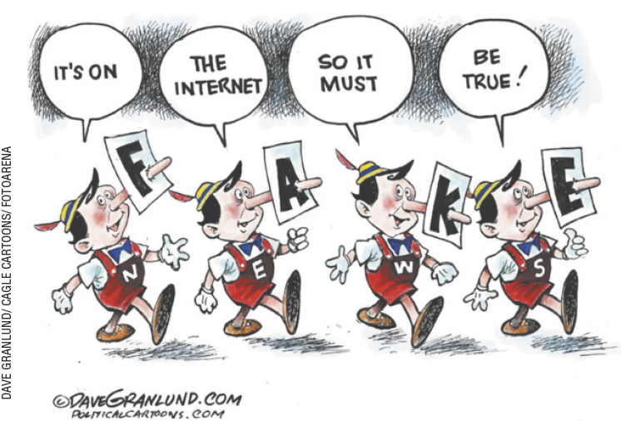
UNIT 1
Modal verbs: should, must
LANGUAGE NOTE
We generally use can’t/cannot to say that something is certainly
not the case.
E.g.: It can’t be true. He’s always
telling lies.
STAFF WRITER. Granlund cartoon: fake news. Gaston Gazette, 8 dez. 2016. Disponível em: www.gastongazette.com/story/opinion/cartoons/2016/12/08/granlund-cartoon-fakenews/24301148007/. Acesso em: 8 jul. 2022.
The modal verb must expresses the deduction or conclusion that something is certain.

