Slide 1
Língua inglesa
CONJUNTO 1
9º ano

Slide 2
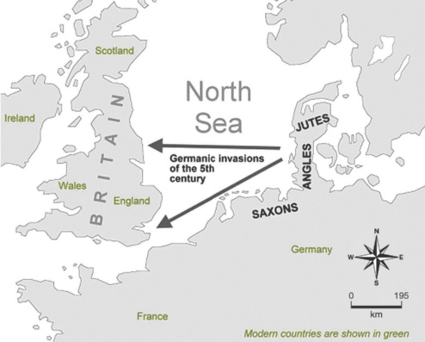
UNIT 0
5th, 6th centuries
9th century
16th century
17th century
18th century
The settlement in Britain of Jutes, Saxons and Angles.
The Viking invasions.
The full flowering of the Renaissance.
The expansion to North America and South Africa.
The expansion to India, Australia, and New Zealand.
Germanic invaders entered Britain on the east and south coasts in the 5th century.
HTTPS://WWW.ENGLISHCLUB.COM
ENGLISH CLUB. History of English. 1997-2022. Disponível em: www.englishclub.com/history-of-english. Acesso em: 1 jul. 2022.

Slide 3
UNIT 0
British colonialism from the seventeenth to the twentieth century.
British leadership in the Industrial Revolution in the eighteenth and nineteenth centuries.
American economic superiority and political leadership in the late nineteenth and early twentieth centuries.
American technological domination in the late twentieth century.
Fonte de pesquisa: FENNELL, A. B. A history of English: a sociolinguistic approach. Hoboken: Blackwell Publishing, 2008.

Slide 4
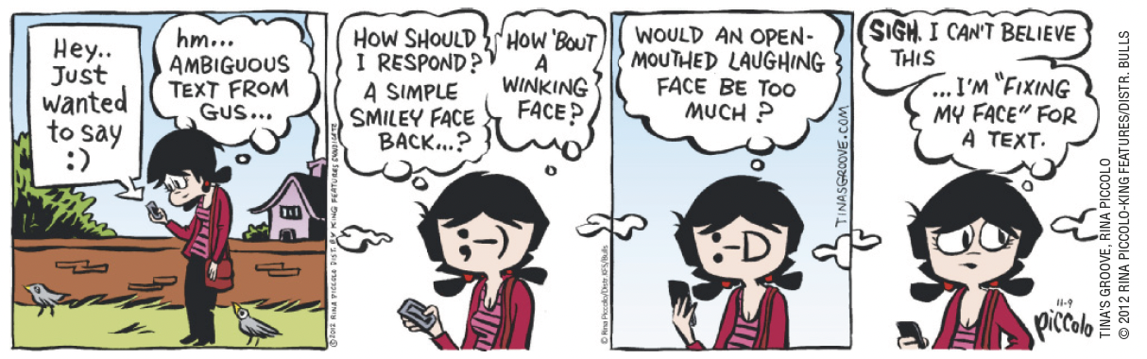
UNIT 0
TIP
Observe as relações entre os elementos verbais e os não verbais.
PICCOLO, Rina. Tina’s Groove. Cartoonist Group. [2022?]. Disponível em: www.cartoonistgroup.com/properties/tinasgroove/art_images/cg50880434b7b40.jpg. Acesso em: 1 jul. 2022.

Slide 5
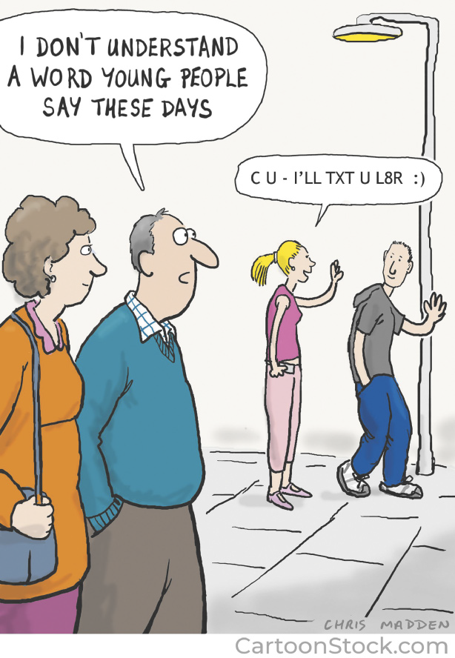
UNIT 0
WWW.CARTOONSTOCK.COM
MADDEN, Chris. I don’t understand a word young people say these days. Cartoonstock. 27 fev. 2020. Disponível em: www.cartoonstock.com/directory/a/abbreviations.asp. Acesso em: 1 jul. 2022.

Slide 6
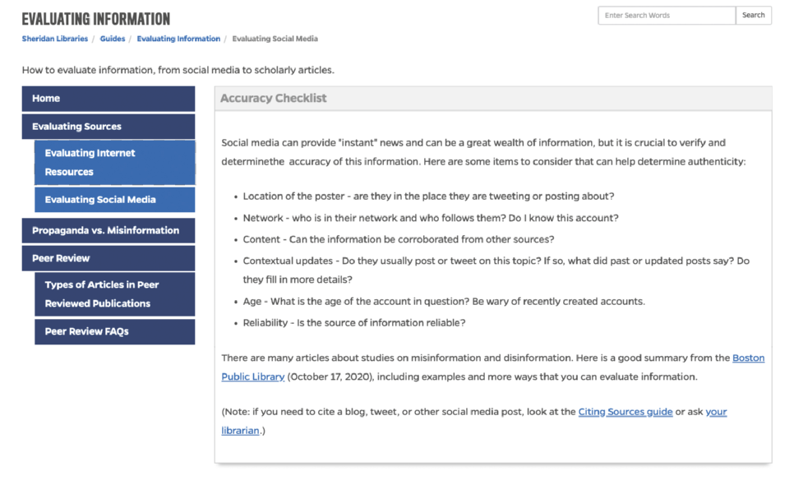
UNIT 0
Evaluating websites
HTTPS://GUIDES.LIBRARY.JHU.EDU/
JOHNS HOPKINS SHERIDAN LIBRARIES. Accuracy checklist. 19 jun. 2021. Disponível em: https://guides.library.jhu.edu/evaluate/social-media. Acesso em: 1 jul. 2022.

Slide 7
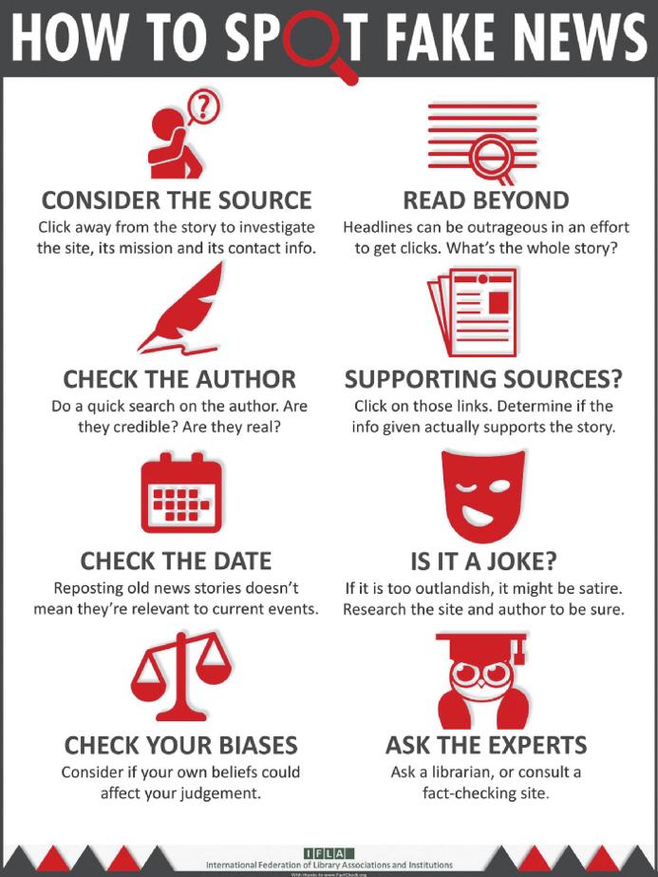
UNIT 0
Evaluating websites
IFLA - INTERNATIONAL FEDERATION OF LIBRARY ASSOCIATIONS AND INSTITUTIONS
McKENZIE, Janis. How to spot fake news: identifying propaganda, satire, and false information. Simon Fraser University. 6 maio 2022. Disponível em: www.lib.sfu.ca/help/research-assistance/fake-news. Acesso em: 1 jul. 2022.

