Slide 1
Língua inglesa
CONJUNTO 1
8º ano

Slide 2
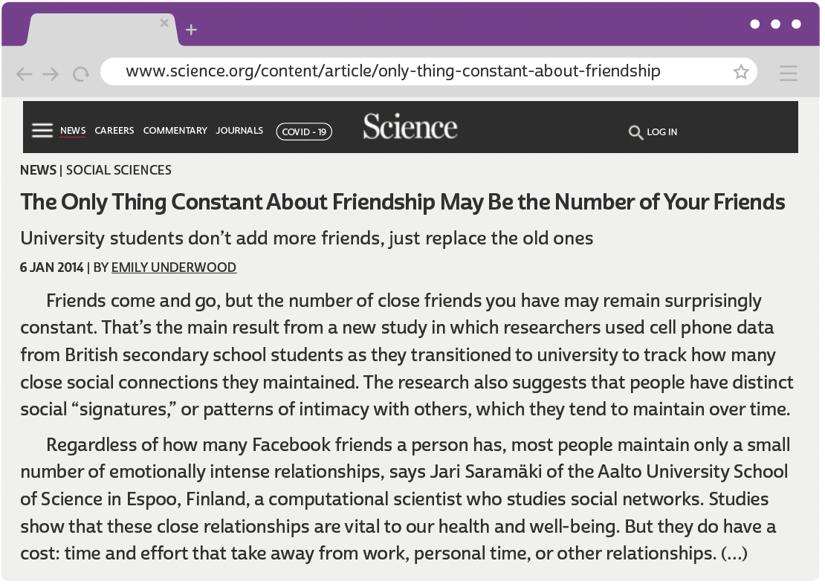
UNIT 8
UNDERWOOD, Emily. The only thing constant about friendship may be the number of your friends. Science, 6 jan. 2014. Disponível em:www.science.org/content/article/only-thing-constant-about-friendship-may-be-number-your-friends. Acesso em: 10 jun. 2022.

Slide 3
UNIT 8
I. “a new study in which researchers used cell phone data”
II. “these close relationships are vital to our health and well-being”
III. “the number of close friends you have may remain surprisingly constant”
WORD FORMATION:
SUFFIXES
-ER
(as in researcher)
-SHIP
(as in relationship)
forms a noun indicating an occupation.
forms a noun indicating a state or condition.
-LY
(as in surprisingly)
forms an adverb indicating a (specified) manner.
LANGUAGE NOTE
Observe que o sufixo -ship não é a sílaba tônica dos substantivos que forma.

Slide 4
UNIT 8
“close friends”
“personal time”
“close social connections”
“these close relationships”
“a computational scientist”
“distinct social ‘signatures’”
“emotionally intense relationships”
“the main result from a new study”
“cell phone data from British secondary school students”
Noun phrases
The main word in each expression is a noun.

Slide 5
UNIT 8
I. “a computational scientist who studies social networks.”
II. “someone whose actions you respect”
III. “time and effort that take away from work”
IV. “patterns of intimacy with others, which they tend to maintain over time.”
Relative pronouns
WHO
THAT
WHICH
WHOSE
refers to “a computational scientist”
refers to “someone"
refers to “time and effort"
refers to “patterns of intimacy with others"
The relative pronouns who, whose, that and which refer to a previous element (= noun or noun phrase).

Slide 6
UNIT 8
We can use
WHO
in reference to
We can use
THAT
in reference to
people
people and things (possessive meaning)
We can use
WHICH
in reference to
things
people and things
We can use
WHOSE
in reference to
Relative pronouns
The relative pronouns who, whose, that and which are used to connect elements in a sentence and to avoid repetition.

Slide 7
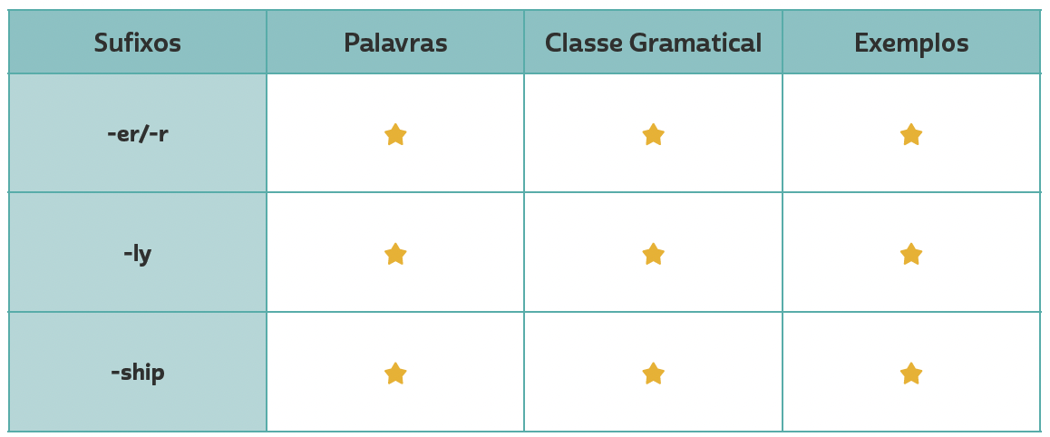
VOCABULARY CORNER
researcher, worker, observer
Personal answers.
noun
Unit 8: word formation: suffixes
gradually, quickly,
surprisingly
adverb
Personal answers.
friendship,
membership,
relationship
Personal answers.
noun

Slide 8
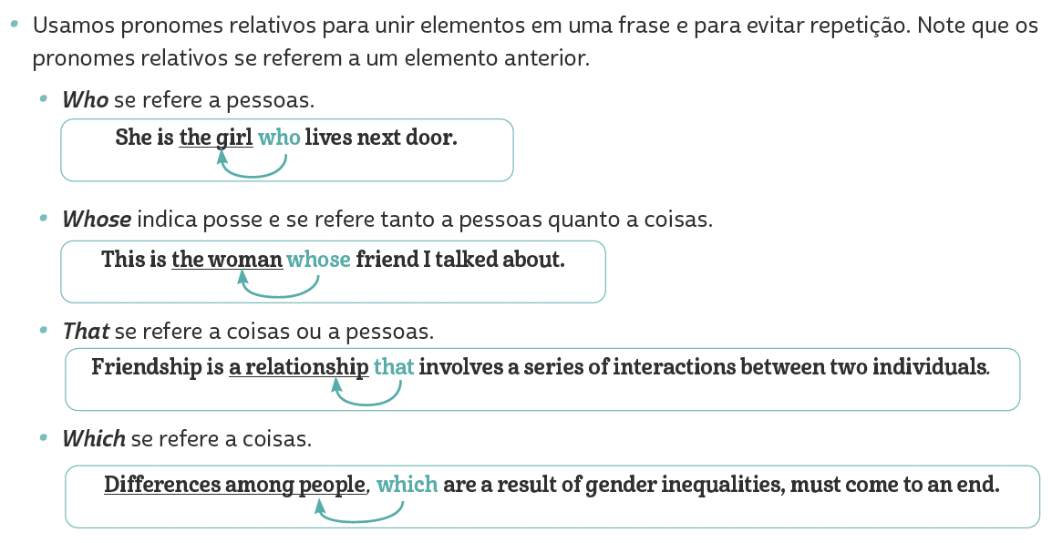
LANGUAGE REFERENCE
Unit 8: relative pronouns

