Slide 1
Língua inglesa
CONJUNTO 1
8º ano

Slide 2
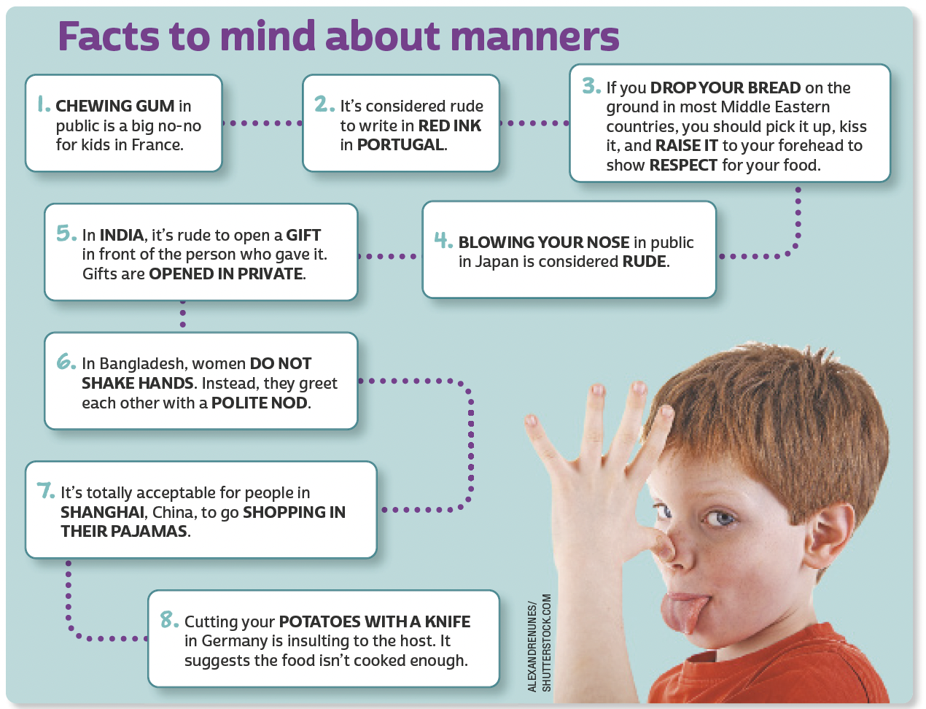
UNIT 6
Adaptado de: NATIONAL GEOGRAPHIC KIDS. 5,000 awesome facts 2 (About everything!). Washington, DC: National Geographic, 2014. p. 74-75.

Slide 3
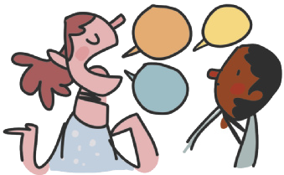
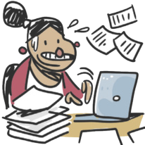
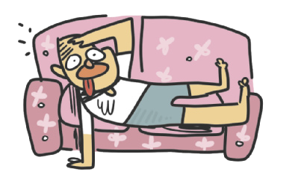
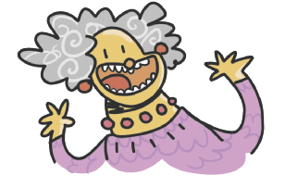
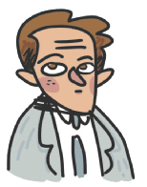
UNIT 6
quiet
talkative
adjectives
hard-working
lazy
LANGUAGE NOTE
My brother is a lazy person.
= My brother is lazy.
I’m a very shy person.
= I’m very shy.
ILUSTRAÇÕES: GALVÃO BERTAZZI
funny
serious

Slide 4
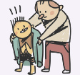
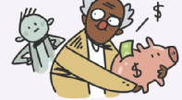
UNIT 6
outgoing/sociable
shy/timid
adjectives
ILUSTRAÇÕES: GALVÃO BERTAZZI
generous
mean

Slide 5
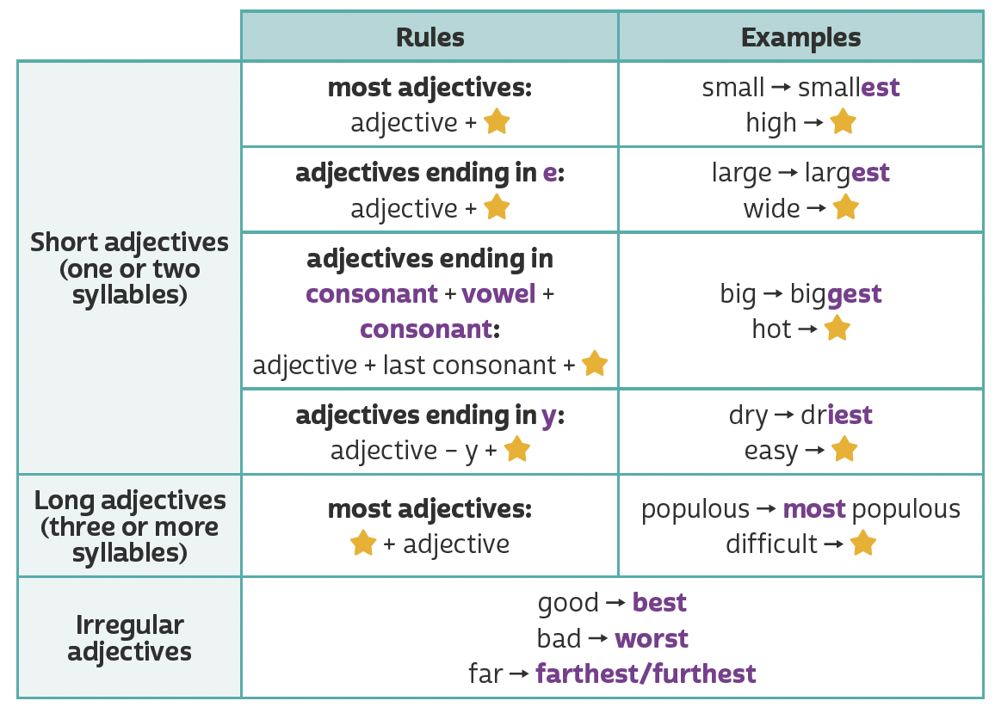
UNIT 6
est
highest
st
widest
Making comparisons (superlative adjectives)
hottest
est
iest
easiest
TIP
most
most difficult
A partir da observação dos exemplos, faça
inferências para
compreender regras
de uso da língua inglesa.

Slide 6
UNIT 6
Making comparisons (superlative adjectives)
the smallest; the loudest
the largest
the driest
the most populous
JUJUBIER/SHUTTERSTOCK.COM

Slide 7
VOCABULARY CORNER
quiet
talkative
Unit 6: adjectives
hard-working
lazy
ILUSTRAÇÕES: GALVÃO BERTAZZI
funny
serious

Slide 8
VOCABULARY CORNER
outgoing/sociable
shy/timid
Unit 6: adjectives
ILUSTRAÇÕES: GALVÃO BERTAZZI
generous
mean

Slide 9
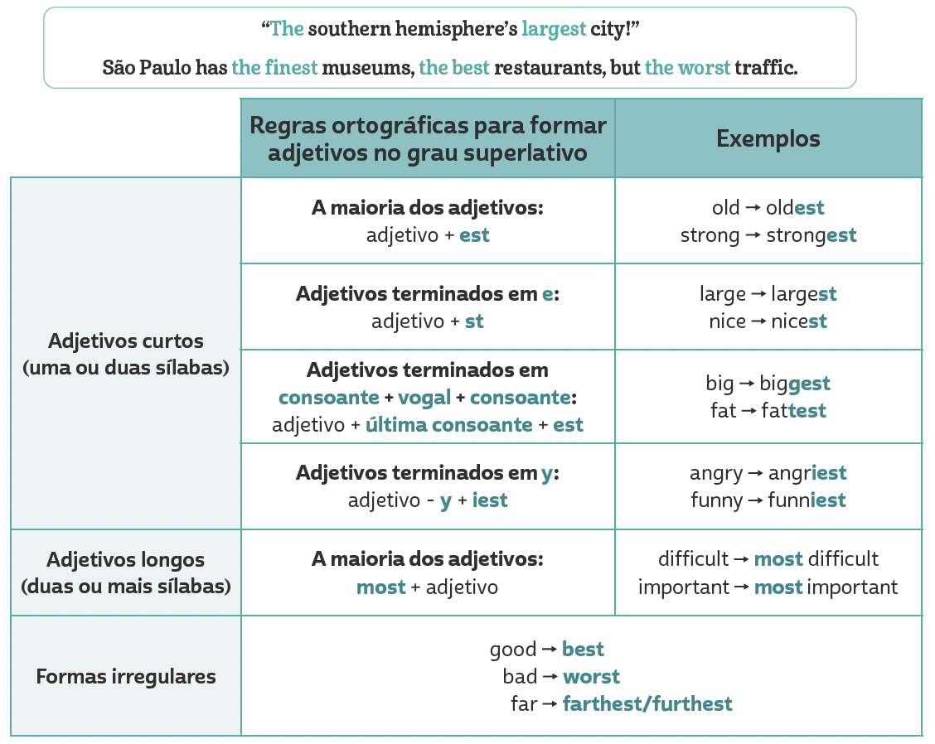
LANGUAGE REFERENCE
Para formar frases no superlativo, usamos the + adjetivo no grau superlativo.
Unit 6:
MAKING COMPARISONS (SUPERLATIVE ADJECTIVES)

