Slide 1
Língua inglesa
CONJUNTO 1
8º ano

Slide 2
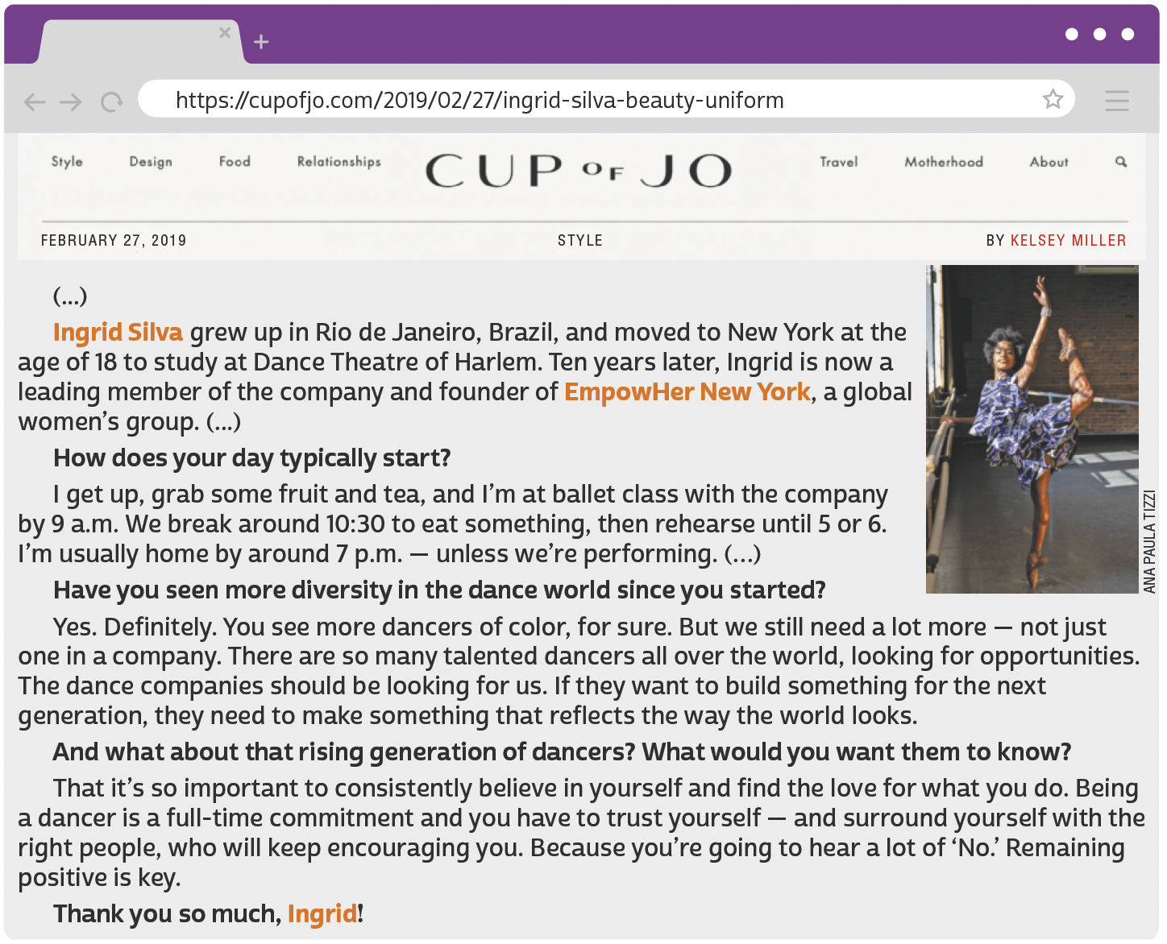
UNIT 4
TIP
A partir do que já
sabemos sobre o gênero
de um texto, podemos
compreendê-lo melhor.
MILLER, Kelsey. My beauty uniform: Ingrid Silva. Cup of Jo, 27 fev. 2019. Disponível em: https://cupofjo.com/2019/02/27/ingrid-silva-beauty-uniform/. Acesso em: 31 maio 2022.

Slide 3
UNIT 4
I. “Yes. Definitely.”
II. “That it’s so important to consistently believe in yourself”
III. “Being a dancer is a full-time commitment”
-LY
(as in definitely, consistently)
-MENT
(as in commitment)
indicates manner.
forms nouns.
WORD FORMATION:
SUFFIXES
LANGUAGE NOTE
Em inglês, acrescenta-se o sufixo
-ly a adjetivos para formar advérbios (consistent ➡️ consistently), assim como em português acrescenta-se o sufixo -mente (consistente ➡️ consistentemente).

Slide 4
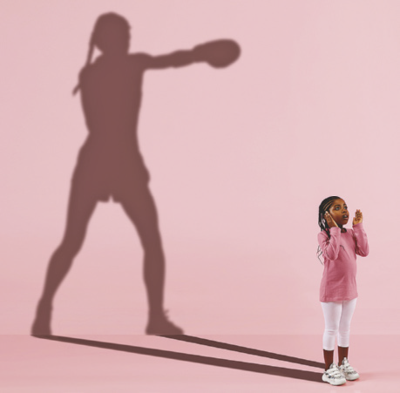
UNIT 4
Asking about future dreams and projects:
What do you want to/wanna do when you’re older?
What are you going to/gonna be when you grow up?
What are you going to/gonna do in ten/twenty/ thirty years?
LANGUAGE NOTE
Talking about future dreams and projects:
When I’m older, I want to/wanna…
I’m going to/gonna be a/an…when I grow up.
In ten/twenty/thirty years, I’m going to/gonna…
wanna ➡️ want to
gonna ➡️ going to
In spoken language, want to is often pronounced /’wɔ:nə/, and going to is often pronounced /’gɔ:nə/. This is sometimes shown in writing as wanna and gonna, respectively, especially in American English.
MASTER1305/SHUTTERSTOCK.COM

Slide 5
UNIT 4
LANGUAGE NOTE
Comparative adjectives in the comic strip:
old + er ➡️ older
(mais velho/a)
smart + er ➡️ smarter
(mais inteligente)
tall + er ➡️ taller
(mais alto/a)
wise + r ➡️ wiser
(mais sábio/a)
BALDO, CANTÚ & CASTELLANOS © 2006 BALDO
PARTNERSHIP / DIST. BY ANDREWS MCMEEL SYNDICATION
CANTÚ, Hector D.; CASTELLANOS, Carlos. Baldo. 2022. Disponível em: www.gocomics.com/baldo/2006/07/01. Acesso em: 31 maio 2022.

Slide 6
VOCABULARY CORNER
Unit 4: word formation: suffixes
consistenly, deeply
adverb
Personal answers.
commitment
noun
Personal answers.

Slide 7
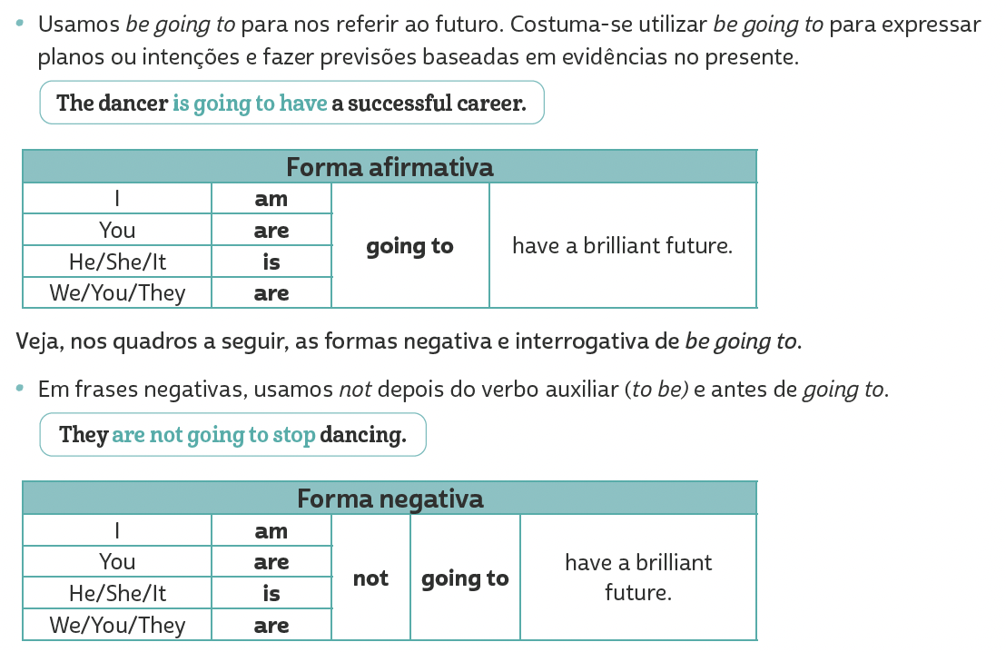
LANGUAGE REFERENCE
Unit 4:
Future with
be going to

Slide 8
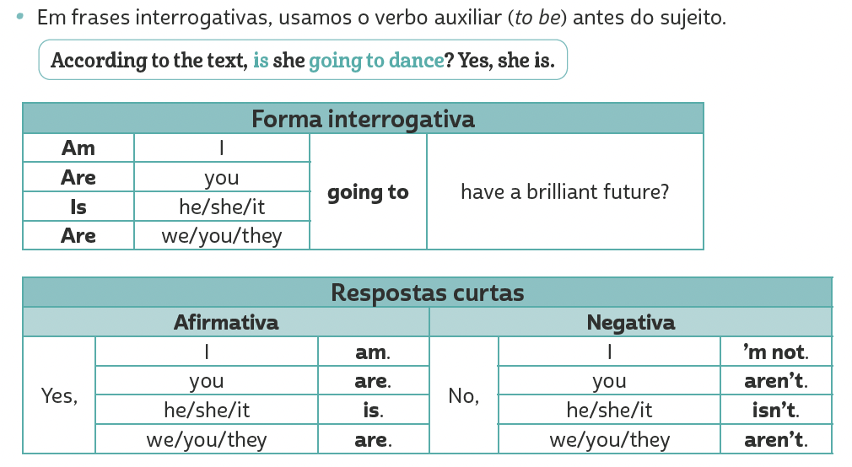
LANGUAGE REFERENCE
Unit 4:
Future with
be going to

