Slide 1
Língua inglesa
CONJUNTO 1
8º ano

Slide 2
UNIT 2
Excerpt 1
The eight-year-old girl who had never been told “You’re worthy; you’re beautiful” suddenly found herself as a leading lady, and a mouthpiece for all the women who looked like her. (...) The obstacle blocking me was a four-hundred-year-old racist system of oppression and my own feeling of utter aloneness. My art, in this instance, was the best healing tool to resolve my past, the best weapon that I had to conquer my present, and my gift to the future.
EARL GIBSON III/GETTY IMAGES FOR BET
PRONUNCIATION NOTE
O primeiro nome da atriz Viola Davis nos remete ao nome de um instrumento musical, tanto em português quanto em inglês, mas, no nome próprio Viola, o “i” é
pronunciado como o pronome “I” /aɪ/.
DAVIS, Viola. Finding me: a memoir. Nova York: HarperCollins Publishers, 2022. p. 279.

Slide 3
UNIT 2
Excerpt 2
Every painful memory, every mentor, every friend and foe served as a chisel, a leap pad that has shaped “ME!” (...) I’m no longer ashamed of me. I own everything that has ever happened to me. The parts that were a source of shame are actually my warrior fuel. I see people – the way they walk, talk, laugh, and grieve, and their silence – in a way that is hyperfocused because of my past. I’m an artist because there’s no separation from me and every human being that has passed through the world including my mom. I have a great deal of compassion for other people, but mostly for myself. That would not be the case if I did not reconcile that little eight-year-old girl and FIND ME.
DAVIS, Viola. Finding me: a memoir. Nova York: HarperCollins Publishers, 2022. p. 291.

Slide 4
UNIT 2
I. “(…) ‘You’re worthy; you’re beautiful’ (…)”
– Excerpt 1
II. “Every painful memory, every mentor (…)”
– Excerpt 2
III. “(…) a four-hundred-year-old racist system of oppression (…)”
– Excerpt 1
IV. “I’m an artist because there’s no separation from me and every human being (…).”
– Excerpt 2
WORD FORMATION:
SUFFIXES
LANGUAGE NOTE
-FUL
(as in beautiful, painful)
-ION
(as in oppression, separation)
meaning: with; full of
turns verbs into nouns
A suffix goes at the end of
a word as in beautiful and
separation.

Slide 5
UNIT 2
III. “(…) a four-hundred-year-old racist system of oppression (…)”
– Excerpt 1
IV. “I’m an artist because there’s no separation from me and every human being (…).”
– Excerpt 2
WORD FORMATION:
SUFFIXES
-IST
(as in racist)
-IST
(as in artist)
forms adjectives as in pacifist, capitalist
refers to occupations
forms nouns as in scientist, journalist.
refers to “someone who believes in or practices something”

Slide 6
UNIT 2
GARFIELD, JIM DAVIS © 1995 PAWS, INC.
ALL RIGHTS DMITR1CH/SHUTTERSTOCK.COM
RESERVED / DIST. BY ANDREWS MCMEEL SYNDICATION
Review: simple past / past continuous
DAVIS, Jim. Garfield. 2022. Disponível em: www.gocomics.com/garfield/1995/03/17. Acesso em: 24 maio 2022.
Garfield wasn’t watching television when Jon arrived.
Garfield was sleeping when Jon entered the room.

Slide 7
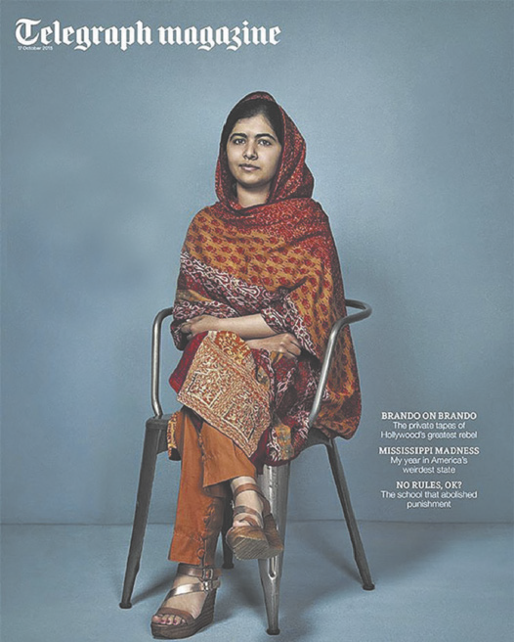
UNIT 2
LANGUAGE NOTE
Nobel laureate.
Icon.
Campaigner.
Daughter.
Schoolgirl.
Inside the ordinary
life of the
extraordinary
Malala
ordinary
= usual, not special
extraordinary
= very unusual, special
a. Who is the woman on the cover of the magazine?
b. What details about her are mentioned on the cover?
c. Based on the cover, does the woman have an ordinary or
extraordinary life?
d. What else do you know about her?
TELEGRAPH MAGAZINE. 17 out. 2015.

Slide 8
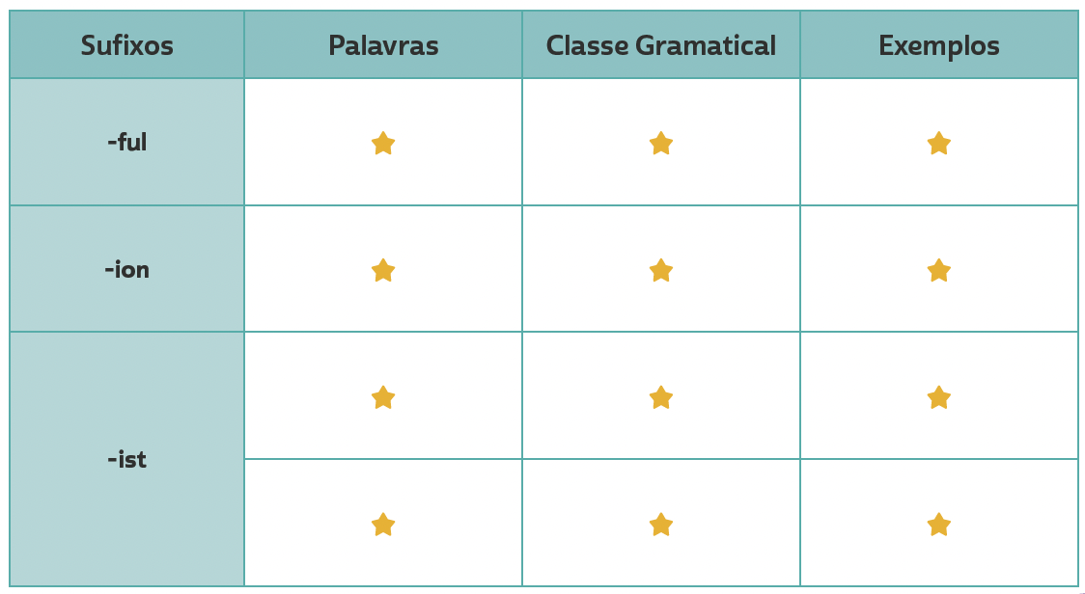
VOCABULARY CORNER
beautiful, painful
Personal answers.
adjective
oppression, separation
Personal answers.
Unit 2: word formation: suffixes
noun
artist, scientist, journalist
noun
Personal answers.
pacifist, racist
Personal answers.
adjective

Slide 9
LANGUAGE REFERENCE
Unit 2:
REVIEW:
SIMPLE PAST/
PAST Continuous

