Slide 1
Língua inglesa
CONJUNTO 1
8º ano

Slide 2
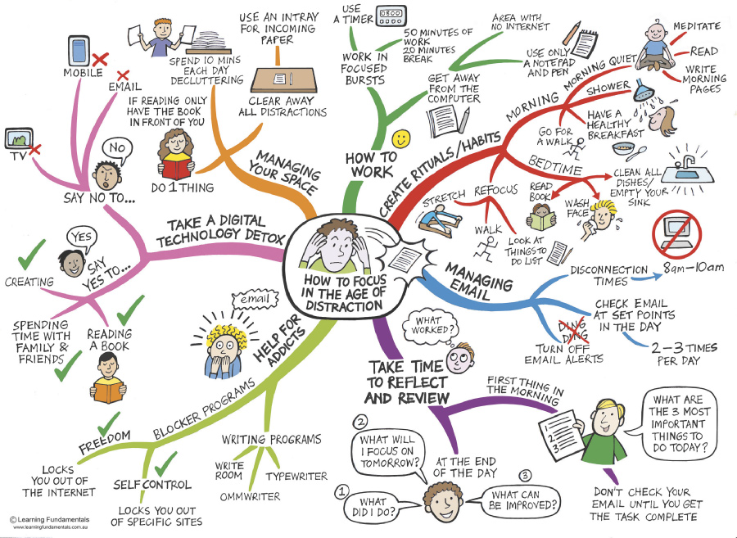
UNIT 1
TIP
© LEARNING FUNDAMENTALS WWW.LEARNINGFUNDAMENTALS.COM.AU
Note que o uso de cores em um mapa conceitual é importante para uma boa organização visual das
informações.
Adaptado de: HOW to focus in the age of distraction. David Hopkins / Education & Leadership. 9 dez. 2013. Disponível em: www.dontwasteyourtime.co.uk/social-network/how-to-focus-in-the-age-of-distraction/. Acesso em: 18 maio 2022.

Slide 3
UNIT 1
Digital devices
timer
television/ TV
computer
Mobile (phone)/ cell (phone)
Word groups
TIP
Agrupar palavras e
expressões por campo
semântico pode ajudar
você a ampliar e fixar o
vocabulário aprendido.

Slide 4
UNIT 1
Daily activities
take/have a shower
stretch
have/eat breakfast
wash face
clean all dishes
walk/ go for a walk
read (a book)
Word groups
TIP
Agrupar palavras e
expressões por campo
semântico pode ajudar
você a ampliar e fixar o
vocabulário aprendido.

Slide 5
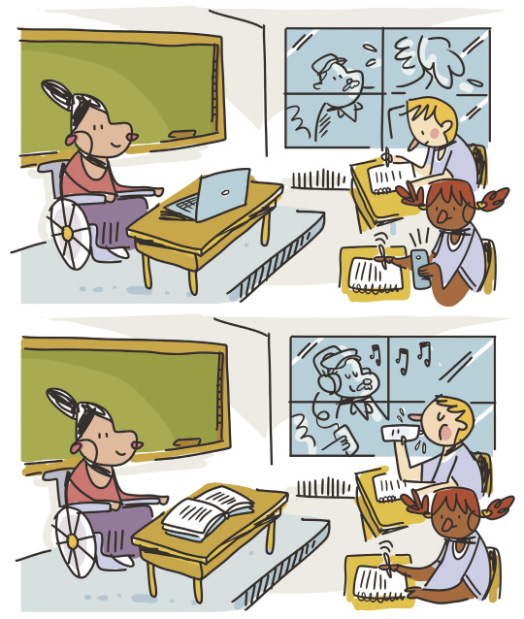
UNIT 1
Review:
simple present / present continuous
In picture A the teacher is using the computer. In picture B she’s reading a book.
ILUSTRAÇÕES: GALVÃO BERTAZZI

Slide 6
UNIT 1
Review:
simple present / present continuous
In picture A the girl is using her cell/mobile (phone) and writing (on her notebook). In picture B she’s only writing (on her notebook).
ILUSTRAÇÕES: GALVÃO BERTAZZI

Slide 7
UNIT 1
Review:
simple present / present continuous
In picture A the boy is writing (on his notebook). In picture B he’s drinking water.
ILUSTRAÇÕES: GALVÃO BERTAZZI

Slide 8
UNIT 1
Review:
simple present / present continuous
In picture A the man is cleaning the window. In picture B he’s listening to music.
ILUSTRAÇÕES: GALVÃO BERTAZZI

Slide 9
VOCABULARY CORNER
Digital devices
mobile (phone)/ cell (phone)
computer
television/ TV
tablet
Unit 1:
WORD GROUPS

Slide 10
VOCABULARY CORNER
Daily activities
take/have a shower
have/eat breakfast
wash face
read (a book)
walk/ go for a walk
stretch
Unit 1:
WORD GROUPS

Slide 11
VOCABULARY CORNER
refocus
review
Personal answers.
Unit 1:
WORD FORMATION: PREFIXES
verb
Personal answers.
disconnection
noun

Slide 12
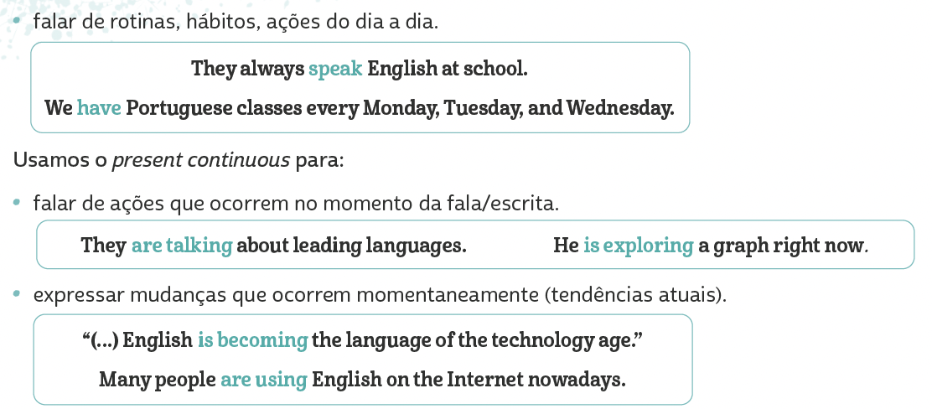
LANGUAGE REFERENCE
Unit 1:
REVIEW:
SIMPLE present/
Present Continuous

Slide 13
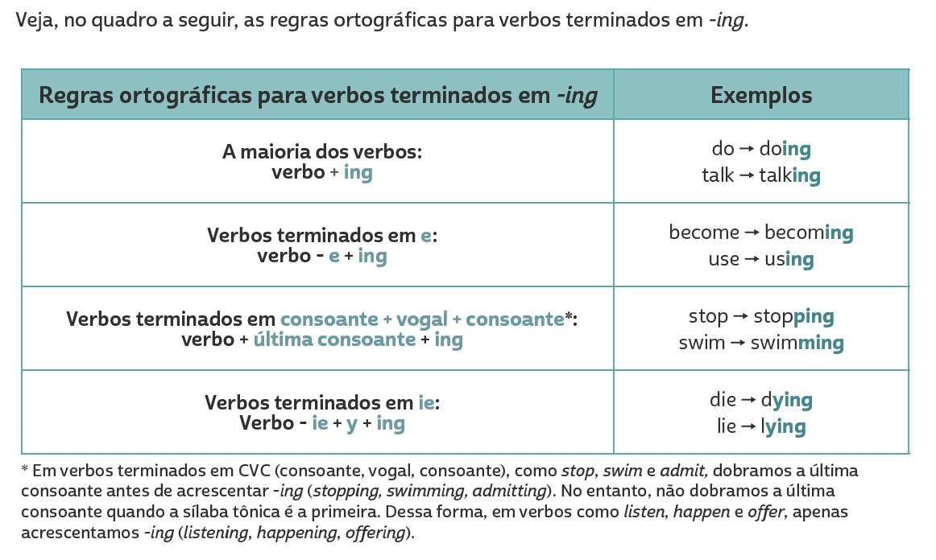
LANGUAGE REFERENCE
Unit 1:
REVIEW:
SIMPLE present/
Present Continuous

