Slide 1
Língua inglesa
CONJUNTO 1
7º ano

Slide 2
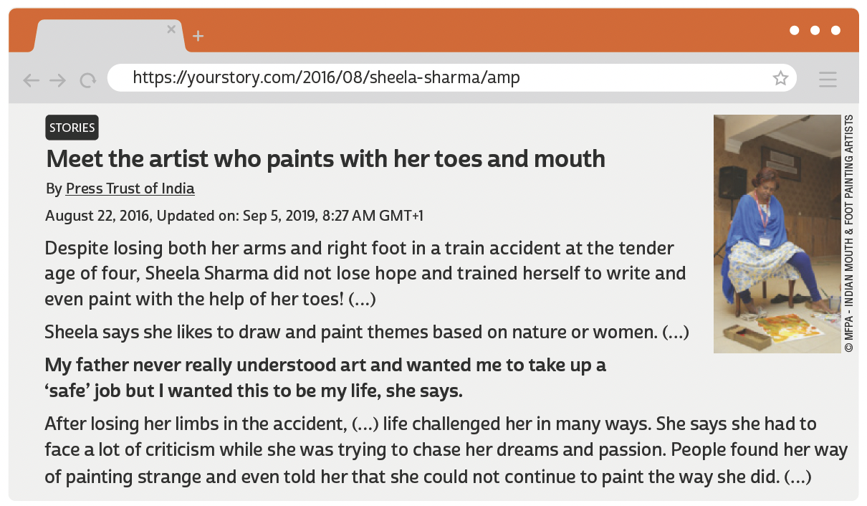
UNIT 8
TIP
Procure observar o título, as
primeiras e as últimas frases
dos parágrafos e palavras-chave repetidas para ajudar
você a antecipar o sentido
global do texto.
PRESS TRUST OF INDIA. Meet the artist who paints with her toes and mouth. HerStory, 2 set. 2019. Disponível em: https://yourstory.com/2016/08/sheela-sharma/amp. Acesso em: 21 jun. 2022.

Slide 3
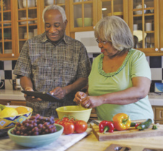
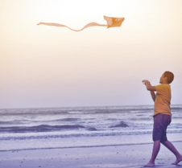
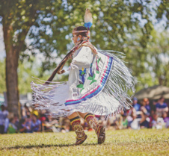
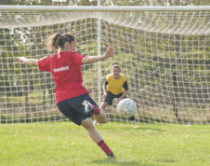
UNIT 8
ROCKETCLIPS, INC./
SHUTTERSTOCK.COM
HAPPY TOGETHER/
SHUTTERSTOCK.COM
cook
fly a kite
ALINA REYNBAKH/
SHUTTERSTOCK.COM
IMAGES PRODUCTS/
SHUTTERSTOCK.COM
abilities
dance
paint
AFRICA STUDIO/
SHUTTERSTOCK.COM
FOTOKOSTIC/
SHUTTERSTOCK.COM
draw
play soccer

Slide 4
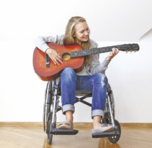
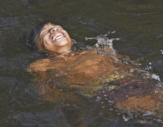
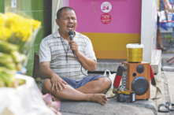
UNIT 8
FLAMINGO IMAGES/
SHUTTERSTOCK.COM
play the guitar
speak English
JACEK CHABRASZEWSKI/
SHUTTERSTOCK.COM
CESAR DINIZ/
PULSAR IMAGENS
abilities
ride a bike
swim
MARLON
LOPEZ MMG1 DESIGN/
SHUTTERSTOCK.COM
2P2PLAY/
SHUTTERSTOCK.COM
sing
whistle

Slide 5
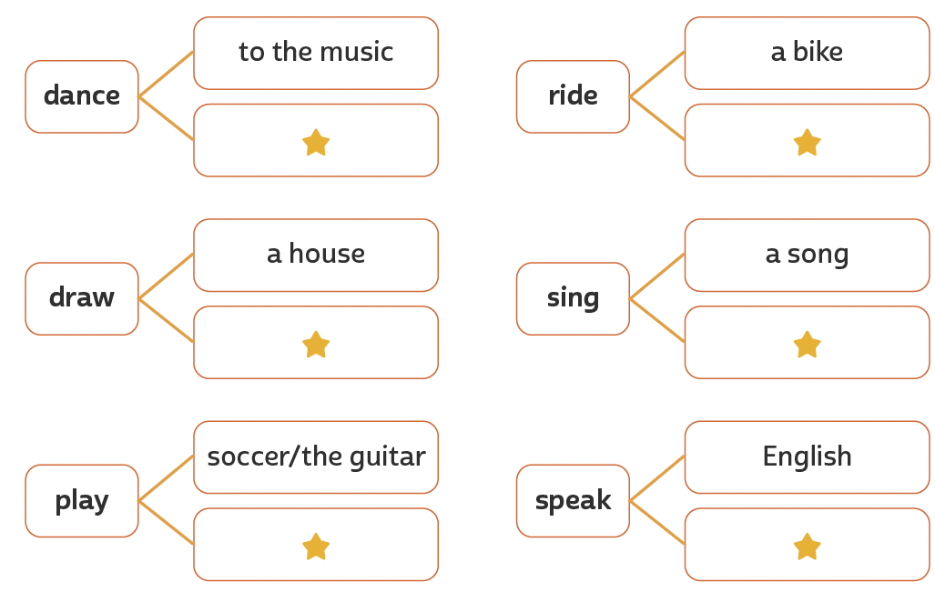
UNIT 8
the tango
a horse
abilities
TIP
a picture
Happy Birthday
Estude combinações possíveis de palavras que costumam ser usadas
em inglês para aumentar seu vocabulário e utilize-as em seus textos. Organizar palavras e
expressões por campo semântico também pode ajudar você a ampliar
e fixar o vocabulário aprendido.
the piano
Portuguese

Slide 6
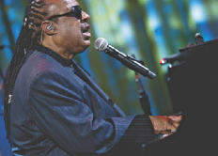
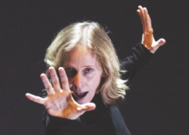
UNIT 8
CORTESIA SEBASTIÃO SALGADO
Sebastião Salgado can photograph pretty well
BRENDAN
SMIALOWSKI /AFP VIA
GETTY IMAGES
Can/could
Stevie Wonder can play the piano and sing very well.
CAFI ESPETÁCULO: VELOX/CIA. DE
DANÇA DEBORAH COLKER
Deborah Colker can dance really well.

Slide 7
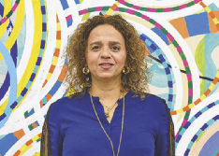
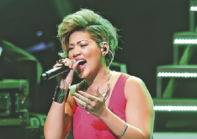
UNIT 8
MATT CROSSICK /
ALAMY/FOTOARENA
Beatriz Milhazes can paint beautifully.
Can/could
WIREIMAGE
Tessanne Chin can sing well

Slide 8
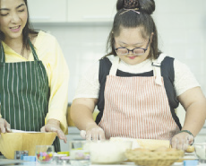
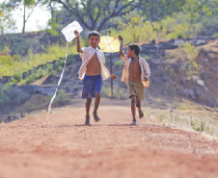
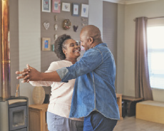
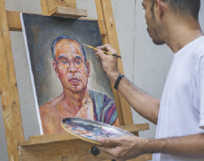
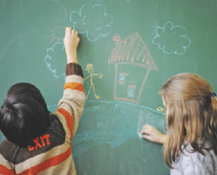
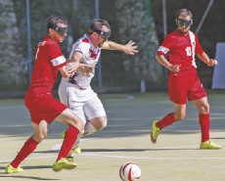
VOCABULARY CORNER
PARTY PEOPLE STUDIO/
SHUTTERSTOCK.COM
NIKS ADS/
SHUTTERSTOCK.COM
cook
fly a kite
MAVO/
SHUTTERSTOCK.COM
HADKHANONG/
SHUTTERSTOCK.COM
Unit 8: abilities
dance
paint
ESB PROFESSIONAL/
SHUTTERSTOCK.COM
VERVERIDIS VASILIS/
SHUTTERSTOCK.COM
draw
play soccer

Slide 9
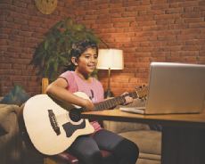
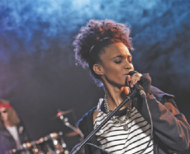
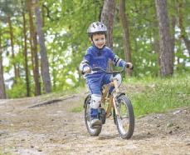
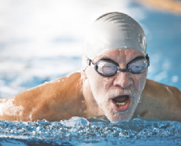
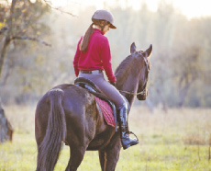
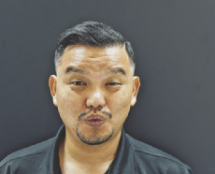
VOCABULARY CORNER
STOCKIMAGEFACTORY.COM/
SHUTTERSTOCK.COM
LIGHTFIELD STUDIOS/
SHUTTERSTOCK.COM
play the guitar
sing
PAVEL KOBYSH/
SHUTTERSTOCK.COM
HALFPOINT/
SHUTTERSTOCK.COM
Unit 8: abilities
ride a bike
swim
SKUMER/
SHUTTERSTOCK.COM
ONGMOJI/
SHUTTERSTOCK.COM
ride a horse
whistle

Slide 10
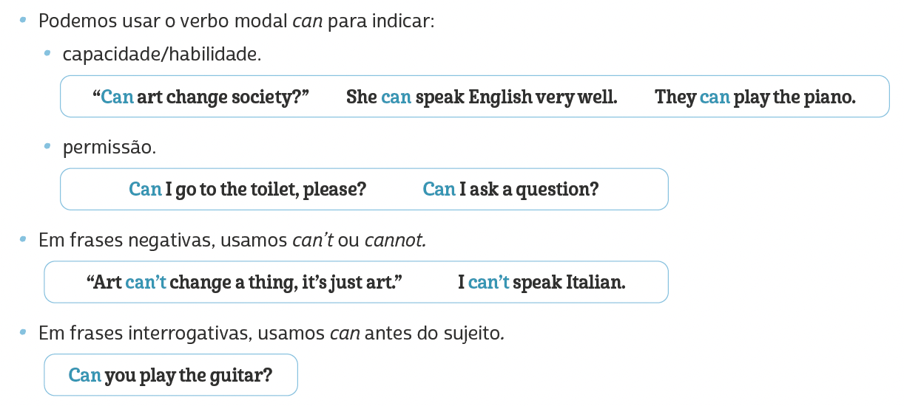
LANGUAGE REFERENCE
Unit 8: can/could

Slide 11
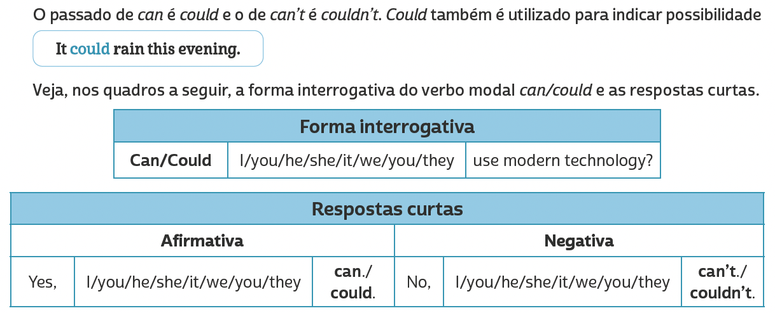
LANGUAGE REFERENCE
Unit 8: can/could

