Slide 1
Língua inglesa
CONJUNTO 1
7º ano

Slide 2
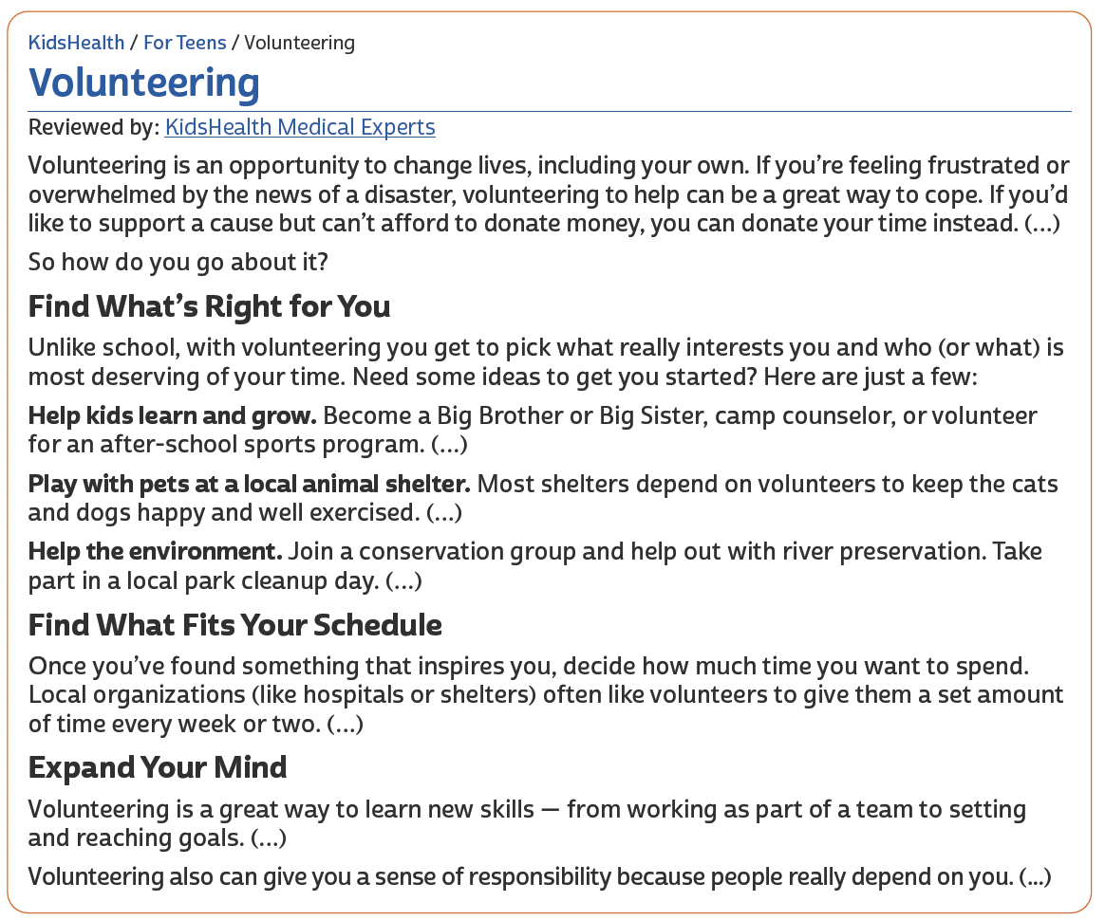
UNIT 7
TIP
Preste atenção ao título e aos
subtítulos para compreender melhor a organização das
ideias no texto.
KIDS HEALTH. Volunteering. 1995-2022. Disponível em: https://web.archive.org/web/20220205040925/https://kidshealth.org/en/teens/volunteering.html. Acesso em: 5 fev. 2022.

Slide 3
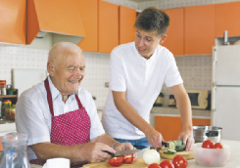
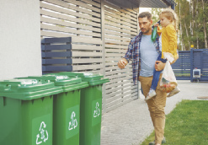
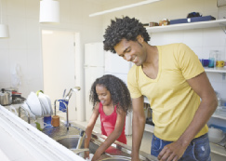
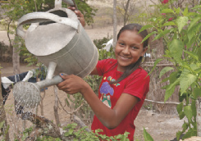
UNIT 7
BEARFOTOS/
SHUTTERSTOCK.COM
GORODENKOFF/
SHUTTERSTOCK.COM
cooking/
preparing a recipe
taking out the trash
JOHN GIUSTINA/
THE IMAGE BANK/
GETTY IMAGES
Household chores
KATE_SEPT2004/E+/
GETTY IMAGES
washing the dishes
making the bed
GONZALO BELL/
SHUTTERSTOCK.COM
SYDA PRODUCTIONS/
SHUTTERSTOCK.COM
watering the plants
sweeping the floor

Slide 4
UNIT 7
condição
I. “If you’re feeling frustrated or overwhelmed by the news of a disaster (…).”
II. “If you’d like to support a cause but can’t afford to donate money (…).”
III. “So how do you go about it?”
IV. “Become a Big Brother or Big Sister (…).”
V. “(…) to keep the cats and dogs happy and well exercised.”
VI. “(…) because people really depend on you.”
oposição
conclusão
LINKING WORDS
alternativa
TIP
Conectores ou palavras de ligação (linking words, em inglês) são palavras utilizadas para unir palavras ou orações. Ao ler um texto, busque
identificar quais palavras ou orações os conectores ligam.
adição
causa

Slide 5
Unit 7
SCOTT DIKKERS
PAST CONTINUOUS
shorter action
(Simple Past)
Dave came over
while
I was putting the bags in the garage.
long action
(Past Continuous)

Slide 6
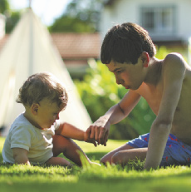
VOCABULARY CORNER
BRICOLAGE/
SHUTTERSTOCK.COM
babysitting
Unit 7: household chores
PROSTOCK-STUDIO/
SHUTTERSTOCK.COM
cooking/ preparing a recipe
ODUA IMAGES/
SHUTTERSTOCK.COM
doing the ironing

Slide 7
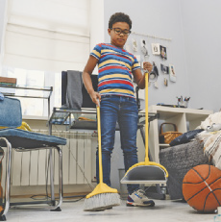
VOCABULARY CORNER
PEOPLEIMAGES.COM - YURI A/
SHUTTERSTOCK.COM
making the bed
Unit 7: household chores
MONKEY BUSINESS IMAGES/
SHUTTERSTOCK.COM
setting the table
DEAN DROBOT/
SHUTTERSTOCK.COM
sweeping the floor

Slide 8
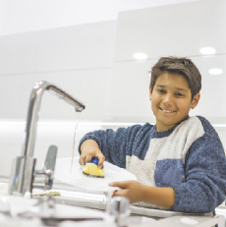
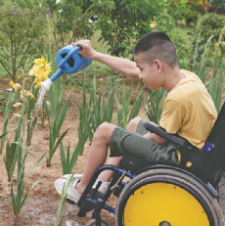
VOCABULARY CORNER
RANTA IMAGES/
SHUTTERSTOCK.COM
taking out the trash
ZURIJETA/
SHUTTERSTOCK.COM
Unit 7: household chores
washing the dishes
ANNGAYSORN/
SHUTTERSTOCK.COM
watering the plants

Slide 9
LANGUAGE REFERENCE
Unit 7: past continuous or simple past?

