Slide 1
Língua inglesa
CONJUNTO 1
7º ano

Slide 2
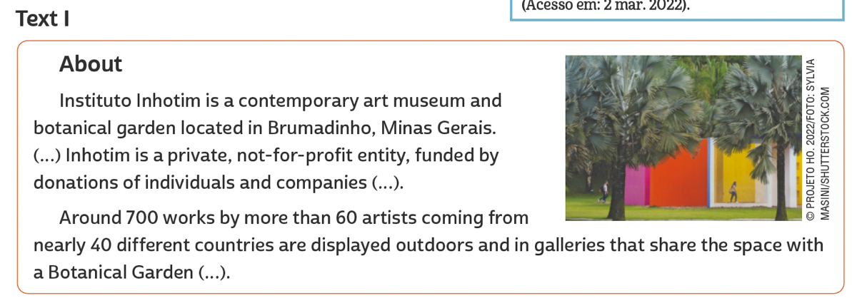
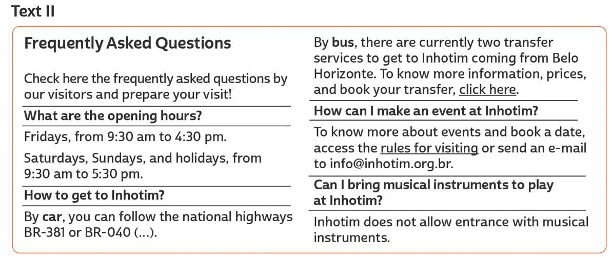
UNIT 3
INHOTIM. About. 2021. Disponível em: www.inhotim.org.br/en/institutional/about/. Acesso em: 21 jun. 2022.
TIP
Ao navegar na internet, observe o endereço do site visitado e veja se o domínio é comercial (.com), educacional (.edu),
acadêmico (.ac), de uma organização não governamental (.org) etc. De que tipo de domínio é o site do texto apresentado?
INHOTIM. Frequently asked questions. 2021. Disponível em: www.inhotim.org.br/en/frequently-asked-questions/. Acesso em: 21 jun. 2022.

Slide 3
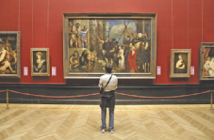
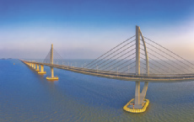
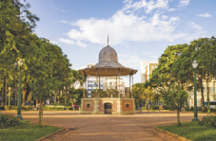
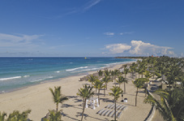
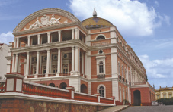
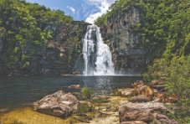
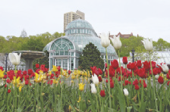
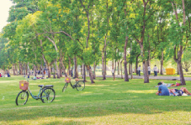
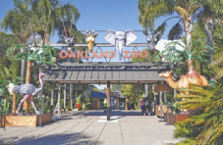
Unit 3
TUPUNGATO/
SHUTTERSTOCK.COM
NICK POON/
SHUTTERSTOCK.COM
HUGO
MARTINS OLIVEIRA/
SHUTTERSTOCK.COM
art museum
bridge
square
Tourist attractions
WWW.GGGPHOTO.COM/
SHUTTERSTOCK.COM
BUMIHILLS/
SHUTTERSTOCK.COM
VITORMARIGO/
SHUTTERSTOCK.COM
beach
opera house
waterfall
ANDY-OSK98/
SHUTTERSTOCK.COM
ZENZETA/
SHUTTERSTOCK.COM
BARBARA ASH/
SHUTTERSTOCK.COM
botanical garden
park
zoo

Slide 4
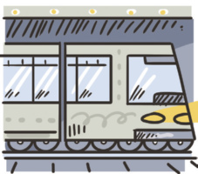
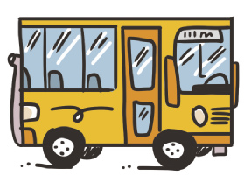
Unit 3
bicycle/bike
car
Means of transportation
boat
metro/subway
LANGUAGE NOTE
ON + foot
BY + bike, boat, bus, car etc.
ILUSTRAÇÕES: GALVÃO BERTAZZI
bus
train

Slide 5
UNIT 3
Como
a. How can you get to the Christ Statue?
By car, train, van or on foot.
b. Where does the train leave from?
Cosme Velho.
c. Why do people choose a van?
Because it’s the easiest option.
d. How many locations are there to get the van?
Three.
e. Who can choose a hike?
People looking for adventure.
Onde
Question words
Por quê
Quanto(s)
Quanta(s)
TIP
We use “Why” in questions
and “because” in answers.
Quem

Slide 6
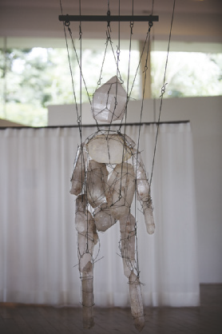
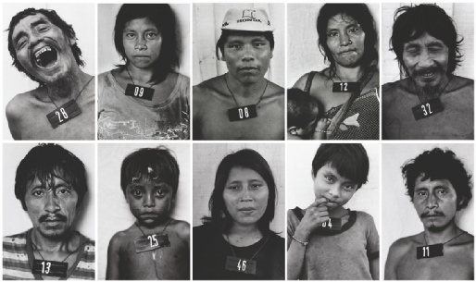
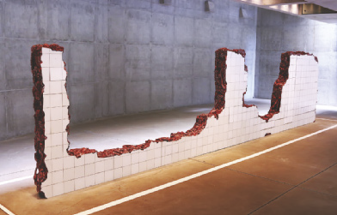
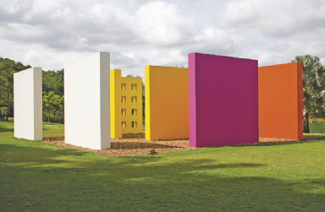
Unit 3
Claudia Andujar (1981-83)
LANGUAGE NOTE
The artwork is large/ small/ geometric/ contemporary/ traditional.
It is made of concrete/ wood/ glass/ paper.
The artist uses vibrant/ pale colors; black and white photos.
It looks like a mosaic/ a puppet/ a broken wall/ building blocks.
I feel amazed/ surprised at the artist’s innovative use of color.
I feel enchanted/ delighted with the geometric shapes of the artwork.
Tunga (2010)
IMAGEM LICENCIADA PELO INSTITUTO TUNGA” /©CHRISTIAN CRAVO; COLEÇÃO DA ARTISTA. CORTESIA GALERIA VERMELHO; ADRIANA VAREJÃO/INSTITUTO INHOTIM, BRUMADINHO, MG. FOTO: ARNALDO JR/SHUTTERSTOCK.COM; © PROJETO HO. 2022/FOTO: VANESSA VOLK/ SHUTTERSTOCK.COM
Adriana Varejão (2004)
Hélio Oiticica (1977)

Slide 7
VOCABULARY CORNER
TUPUNGATO/
SHUTTERSTOCK.COM
NICK POON/
SHUTTERSTOCK.COM
HUGO
MARTINS OLIVEIRA/
SHUTTERSTOCK.COM
art museum
bridge
square
WWW.GGGPHOTO.COM/
SHUTTERSTOCK.COM
BUMIHILLS/
SHUTTERSTOCK.COM
VITORMARIGO/
SHUTTERSTOCK.COM
Unit 3: tourist attractions
beach
opera house
waterfall
ANDY-OSK98/
SHUTTERSTOCK.COM
ZENZETA/
SHUTTERSTOCK.COM
BARBARA ASH/
SHUTTERSTOCK.COM
botanical garden
park
zoo

Slide 8
VOCABULARY CORNER
bicycle/bike
car
Unit 3: means of transportation
boat
metro/subway
ILUSTRAÇÕES: GALVÃO BERTAZZI
bus
train

Slide 9
LANGUAGE REFERENCE
Unit 3:
Question words

