Slide 1
Língua inglesa
CONJUNTO 1
7º ano

Slide 2
UNIT 2
TIP
Apoie-se em palavras parecidas com o português para fazer previsões sobre o texto e compreendê-lo.
SPECIAL OLYMPICS. Mission. In: SPECIAL OLYMPICS. About. 2022. Disponível em: www.specialolympics.org/about/mission. Acesso em: 21 jun. 2022.

Slide 3
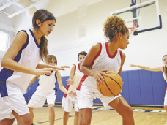
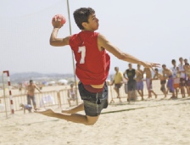
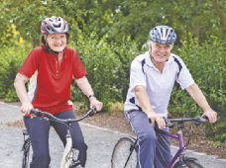
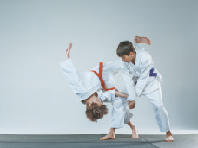
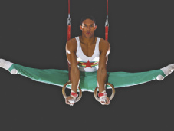
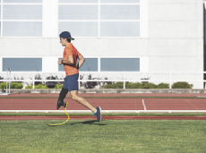
UNIT 2
basketball
handball
sports
MASTER1305/
SHUTTERSTOCK.COM
cycling
judo
JUICE DASH/
SHUTTERSTOCK.COM
ANTYPAN/
SHUTTERSTOCK.COM
gymnastics
running

Slide 4
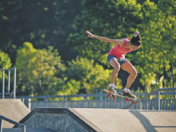
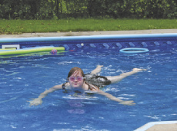
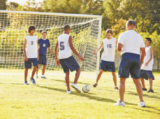
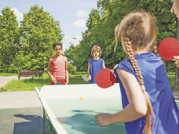
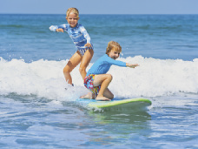
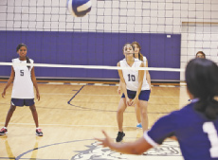
UNIT 2
LZF/SHUTTERSTOCK.COM
ANNSCREATIONS/
SHUTTERSTOCK.COM
skateboarding
swimming
MONKEY
BUSINESS IMAGES/
SHUTTERSTOCK.COM
sports
SERGEY NOVIKOV/
SHUTTERSTOCK.COM
soccer
table tennis
MONKEY
BUSINESS IMAGES/
SHUTTERSTOCK.COM
DENIS MOSKVINOV/
SHUTTERSTOCK.COM
surfing
volleyball

Slide 5
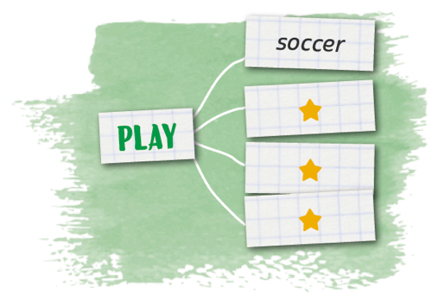
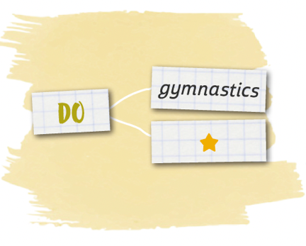
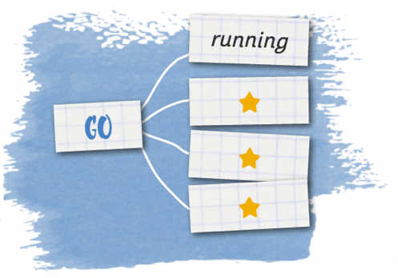
UNIT 2
soccer
handball
table tennis
volleyball
sports
gymnastics
judo
LANGUAGE NOTE
PLAY + ball or team sports
(play basketball, soccer)
DO + non-team sports
(do gymnastics, judo)
GO + sports that end in –ing
(go cycling, swimming)
running
skateboarding
surfing
swimming

Slide 6
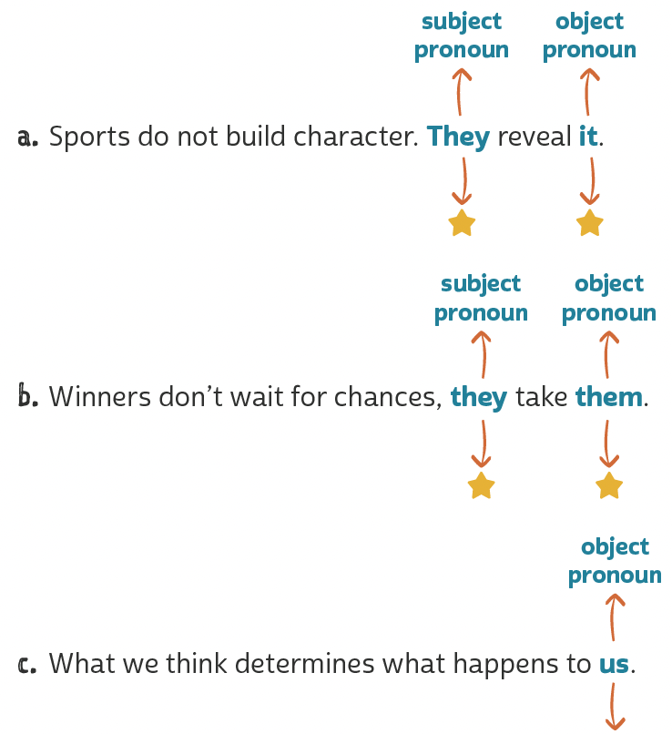
UNIT 2
= sports
= character
Object pronouns
TIP
= winners
= chances
Ao encontrar um pronome como me, you, him, her, it, us e them em uma frase, busque
identificar a que termo esse pronome se refere.
= we

Slide 7
UNIT 2
HTTPS://WWW.PASSITON.COM/
PASS IT ON. Marlon Shirley: lost leg, not heart. 1999-2022. Disponível em: https://assets.passiton.com/billboards/new_images/medium/overcoming_marlon_shirley.jpg?1558454270. Acesso em: 23 jun. 2022.
Quem deve ser Marlon Shirley?
O que “Lost leg, not heart.” significa?
Qual valor ou princípio está sendo promovido no texto?
Na sua opinião, qual é o objetivo de textos como este?

Slide 8
VOCABULARY CORNER
basketball
handball
Unit 2: SPORTS
MASTER1305/
SHUTTERSTOCK.COM
cycling
judo
JUICE DASH/
SHUTTERSTOCK.COM
ANTYPAN/
SHUTTERSTOCK.COM
gymnastics
running

Slide 9
VOCABULARY CORNER
LZF/SHUTTERSTOCK.COM
ANNSCREATIONS/
SHUTTERSTOCK.COM
skateboarding
swimming
MONKEY
BUSINESS IMAGES/
SHUTTERSTOCK.COM
Unit 2: SPORTS
SERGEY NOVIKOV/
SHUTTERSTOCK.COM
soccer
table tennis
MONKEY
BUSINESS IMAGES/
SHUTTERSTOCK.COM
DENIS MOSKVINOV/
SHUTTERSTOCK.COM
surfing
volleyball

Slide 10
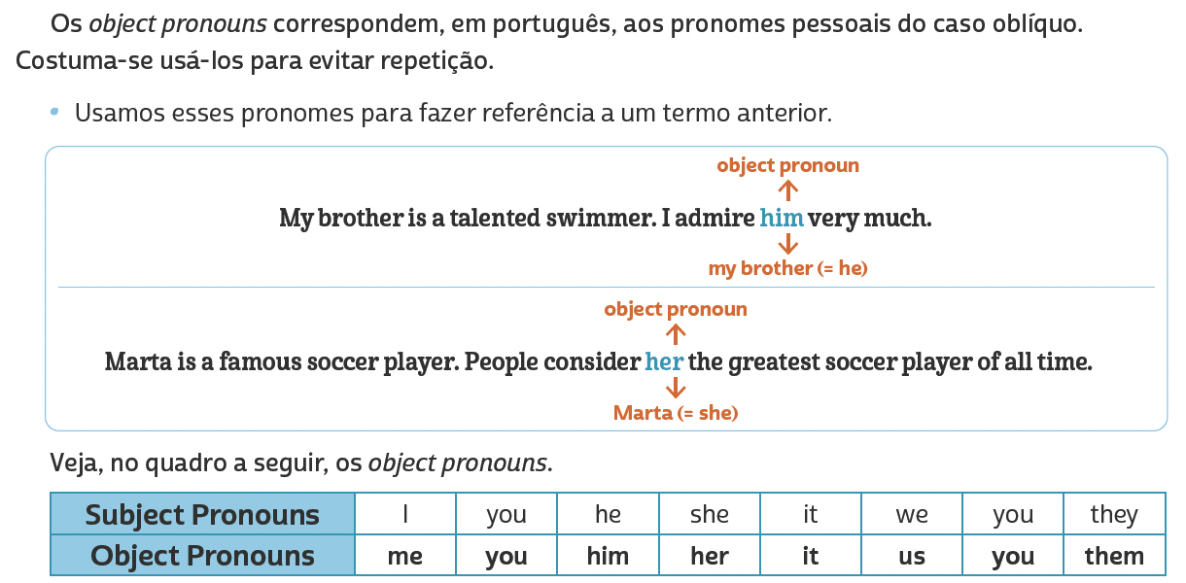
LANGUAGE REFERENCE
Unit 2:
Object pronouns

Slide 11
LANGUAGE REFERENCE
Unit 2:
Object pronouns

