Slide 1
Língua inglesa
CONJUNTO 1
7º ano

Slide 2
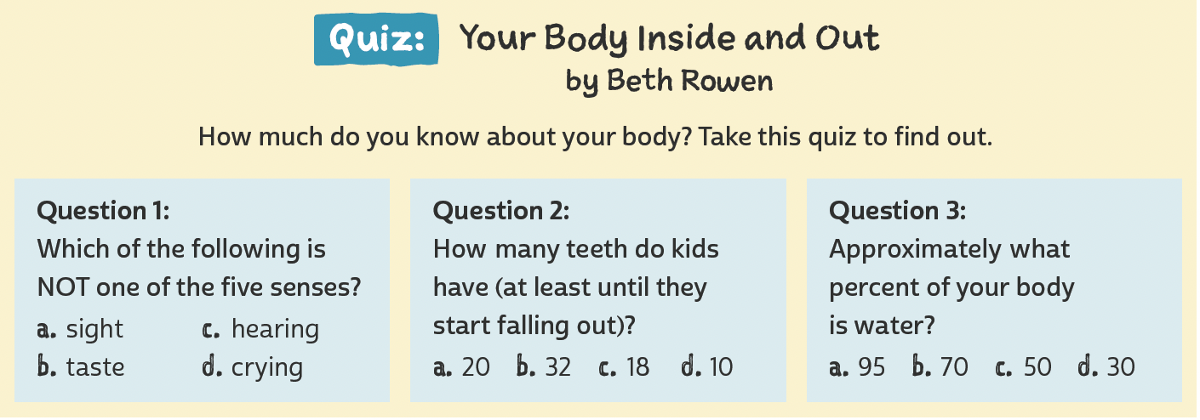
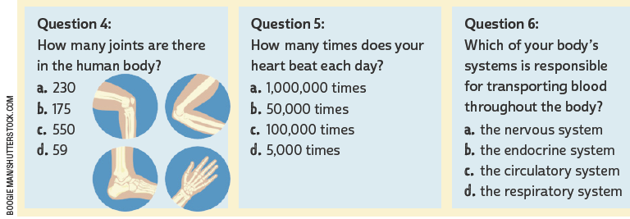
UNIT 1
LANGUAGE NOTE
We use How many…? to ask about the number of things or people (quantity).
How many friends do you have?
I have about 10 friends.
Adaptado de: ROWEN, Beth. Quiz: your body inside and out. Fact Monster. 2000-2019. Disponível em: www.factmonster.com/take-quiz/your-body-inside-out. Acesso em: 19 jun. 2022.

Slide 3
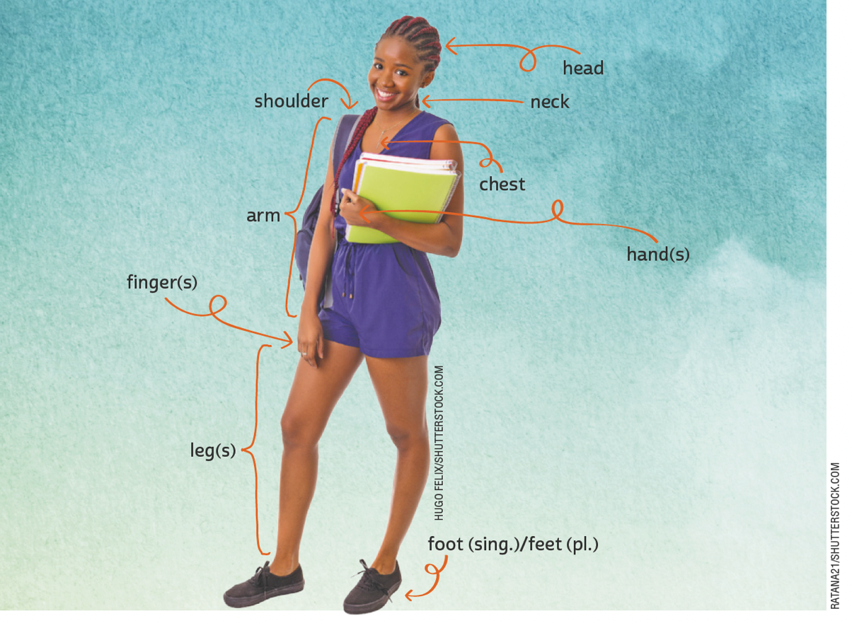
UNIT 1
head
shoulder
neck
chest
arm
The human body
finger(s)
hand(s)
leg(s)
foot (sing.)/feet (pl.)

Slide 4
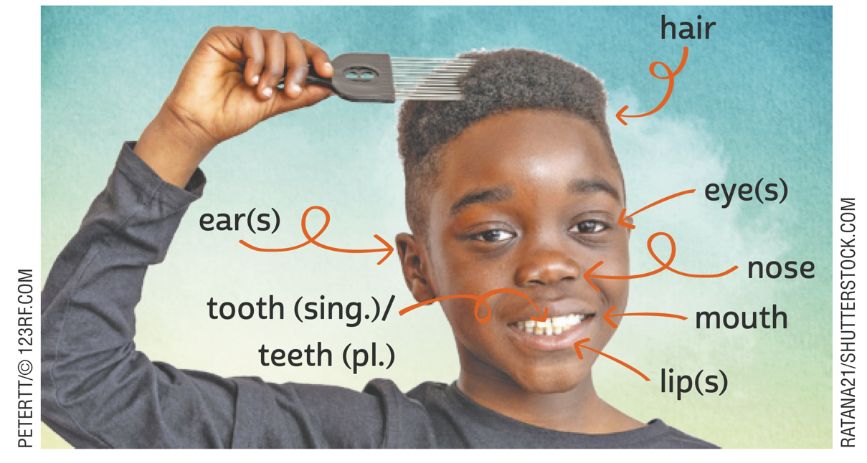
UNIT 1
hair
The human body
eye(s)
ear(s)
nose
tooth (sing.)/
teeth (pl.)
mouth
lip(s)
LANGUAGE NOTE
singular plural
tooth teeth
foot feet

Slide 5
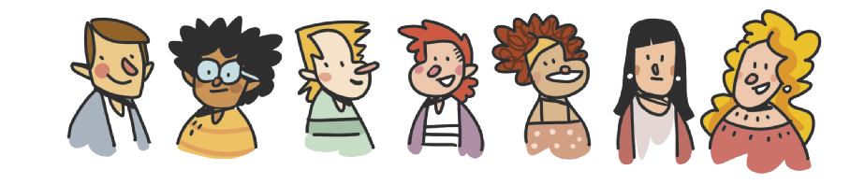
UNIT 1
eyes
brown
black
green
blue
The human body
hair
brown
blond
curly
wavy
black
ginger
straight
ILUSTRAÇÕES: GALVÃO BERTAZZI

Slide 6
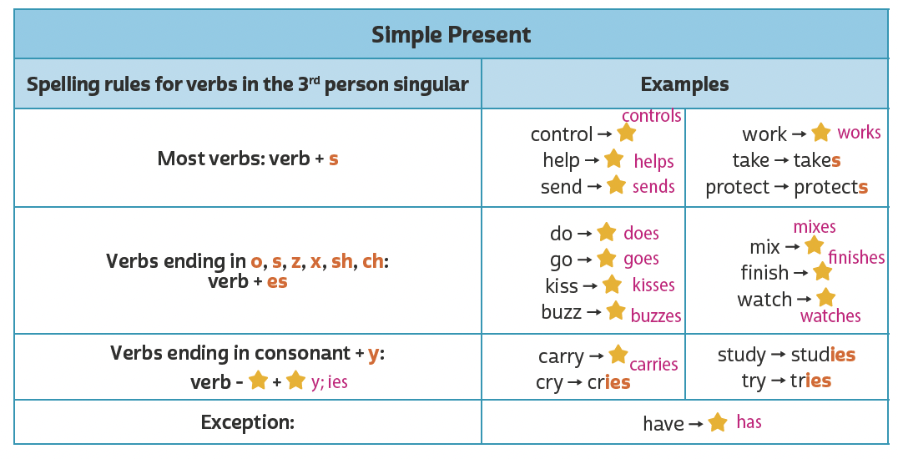
UNIT 1
REVIEW:
Simple present

Slide 7
UNIT 1
always
often/ frequently
sometimes
rarely
never
usually
100%
0%
Adverbs of frequency

Slide 8
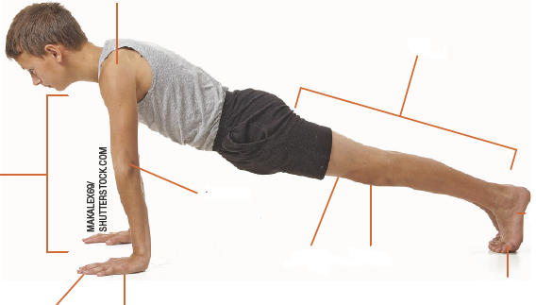
VOCABULARY CORNER
shoulder
foot (sing.)/
feet (pl.)
leg
Unit 1:
THE HUMAN BODY
arm
elbow
knee
thigh
toe
finger
hand

Slide 9
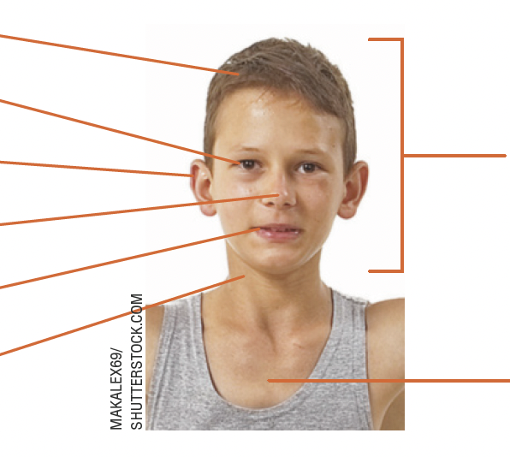
VOCABULARY CORNER
hair
eye
ear
head
Unit 1:
THE HUMAN BODY
nose
mouth
neck
chest

Slide 10
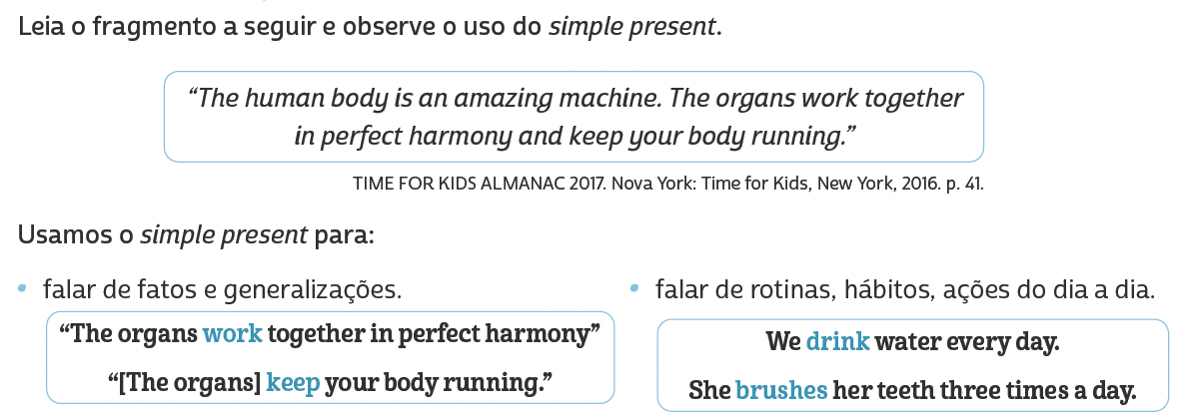
LANGUAGE REFERENCE
Unit 1:
REVIEW SIMPLE PRESENT

Slide 11
LANGUAGE REFERENCE
always
often/ frequently
sometimes
rarely
never
usually
100%
0%
Unit 1:
Adverbs of frequency

