Slide 1
Língua inglesa
CONJUNTO 1
6º ano

Slide 2

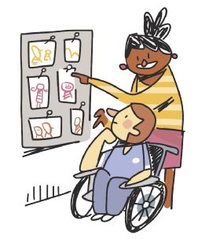
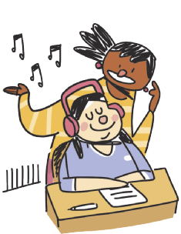
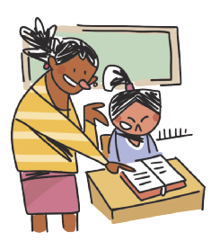
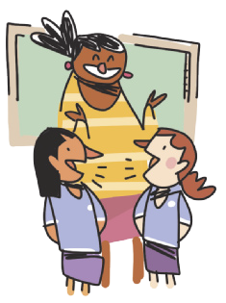
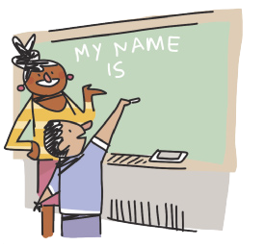
CLASSROOM LANGUAGE
WORK in groups.
LOOK at the photos.
READ the text.
LISTEN to the song.
ILUSTRAÇÕES: GALVÃO BERTAZZI
WRITE your name on the board.
TALK to your classmate.

Slide 3
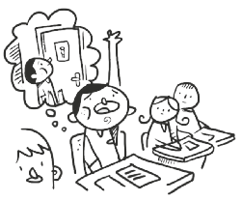
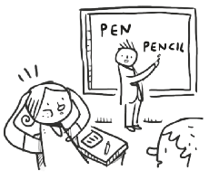
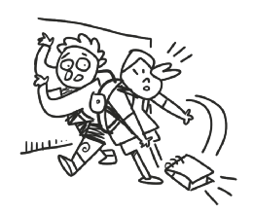
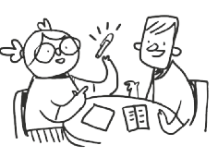
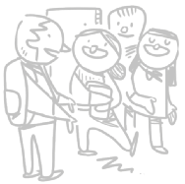
CLASSROOM LANGUAGE
May I go to the toilet?
I don’t understand.
I’m sorry.
How do you say “caneta” in English?
Excuse me.
ILUSTRAÇÕES: GALVÃO BERTAZZI

Slide 4
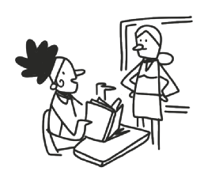

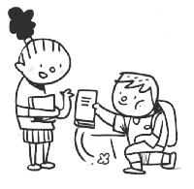
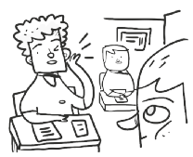
CLASSROOM LANGUAGE
What page?
Can you help me, please?
Thank you.
Can you repeat that, please?
ILUSTRAÇÕES: GALVÃO BERTAZZI

Slide 5
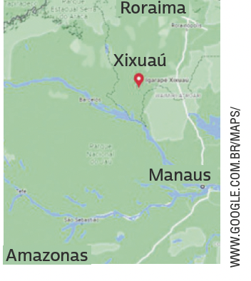
UNIT 8
My name is Mecias, and I am ten years old. I live in a village in the middle of the rainforest.
In my village, there are a few houses surrounded by the jungle, which has lots of animals and birds. We go fishing in
canoes built by the people here in the village. There is a crocodile in the village port!
At my school there are nineteen children, ranging in age from four to sixteen years old. We all study in the same classroom. We have wireless internet and a computer in our classroom! We study mathematics, the Portuguese language, history, natural sciences and geography, and very often we talk about conservation.
We learn not to throw rubbish into the river, not to kill the
animals, and not to cut down trees unnecessarily. I like my class.
My classmates, my teacher, and I like being in the middle of the forest and breathing clean air.
THINK ABOUT IT!
Em algumas regiões do Brasil, é um desafio assegurar acesso a escolas para crianças e adolescentes. Que consequências a falta de educação escolar pode ter na vida desses jovens? Em sua opinião, o que deve ser feito para garantir que todas as
crianças e adolescentes no Brasil frequentem a escola?
HUGHES, Susan. Off to class: incredible and unusual schools around the world. Toronto: Owlkids Books, 2011. p. 12.

Slide 6
UNIT 8
We
go
fishing.
study
about conservation.
talk
mathematics.
the Portuguese language.
history.
natural sciences.
geography.
learn not to throw
rubbish into the river.
Action verbs
TIP
Diagramas como este podem ajudar você a agrupar palavras e expressões por temas e, assim, contribuir para a ampliação e a fixação do vocabulário aprendido. Você pode fazer isso no papel ou no computador.

Slide 7
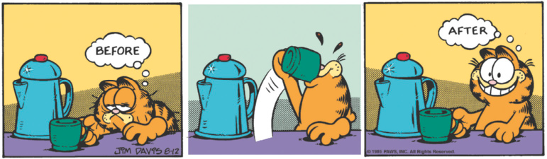
UNIT 8
GARFIELD, JIM DAVIS © 1985 PAWS, INC.
ALL RIGHTS RESERVED / DIST.
BY ANDREWS MCMEEL SYNDICATION
TIP
DAVIS, Jim. Garfield. 2022. Disponível em: www.gocomics.com/garfield/1985/08/12. Acesso em: 9 jun. 2022..
Ao ler tirinhas, observe as relações entre os elementos verbais e os não verbais.
LANGUAGE NOTE
Uma forma de organizar o vocabulário que aprendeu é usar antônimos, como em:
before X after
love X hate
sleep X wake up

Slide 8
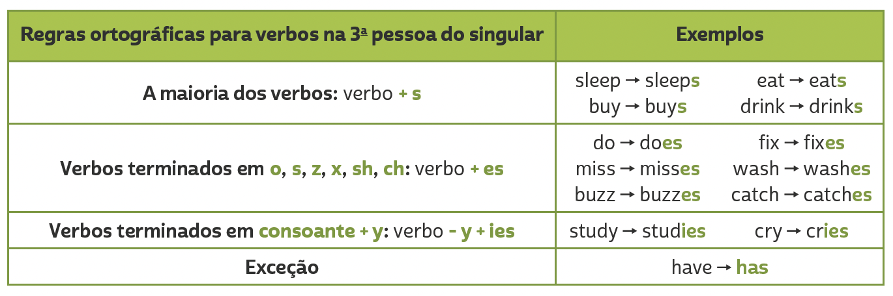
UNIT 8
Simple present
(He/SHE/IT)

Slide 9
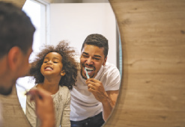


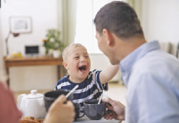

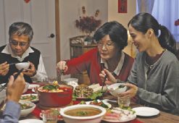
VOCABULARY CORNER
YUGANOV KONSTANTIN/
SHUTTERSTOCK.COM
BBERNARD/
SHUTTERSTOCK.COM
brush my teeth
go to school
HALFPOINT/
SHUTTERSTOCK.COM
Unit 8: action verbs
PRESSMASTER/
SHUTTERSTOCK.COM
do homework
have/eat breakfast
PRPICTURESPRODUCTION/
SHUTTERSTOCK.COM
UFABIZPHOTO/
© 123RF.COM
go to bed
have/eat dinner

Slide 10






VOCABULARY CORNER
MONKEY BUSINESS IMAGES/
SHUTTERSTOCK.COM
VALIZA/SHUTTERSTOCK.COM
have/eat lunch
take a shower
THIRAWATANA
PHAISALRATANA/
SHUTTERSTOCK.COM
TRAVELPIXS/
SHUTTERSTOCK.COM
Unit 8: action verbs
play with the dog
wake up
WAVEBREAKMEDIA/
SHUTTERSTOCK.COM
DANI LLAO CALVET/
SHUTTERSTOCK.COM
sleep
watch TV

Slide 11






VOCABULARY CORNER
Arts/Art
History
Unit 8: school subjects
English
ICT (Information and Communication Technologies)
ILUSTRAÇÕES: GALVÃO BERTAZZI
Geography
Literature

Slide 12



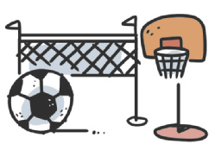

VOCABULARY CORNER
Maths/Math/Mathematics
Science
Unit 8: school subjects
Physical Education (P.E.)
Spanish
ILUSTRAÇÕES: GALVÃO BERTAZZI
Portuguese

Slide 13
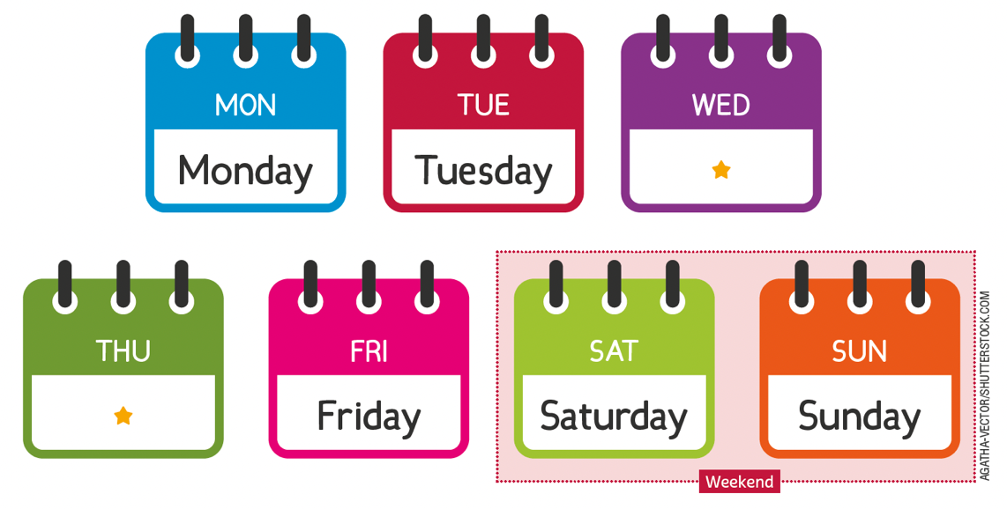
VOCABULARY CORNER
Wednesday
Unit 8: days of the week
Thursday
weekend

Slide 14
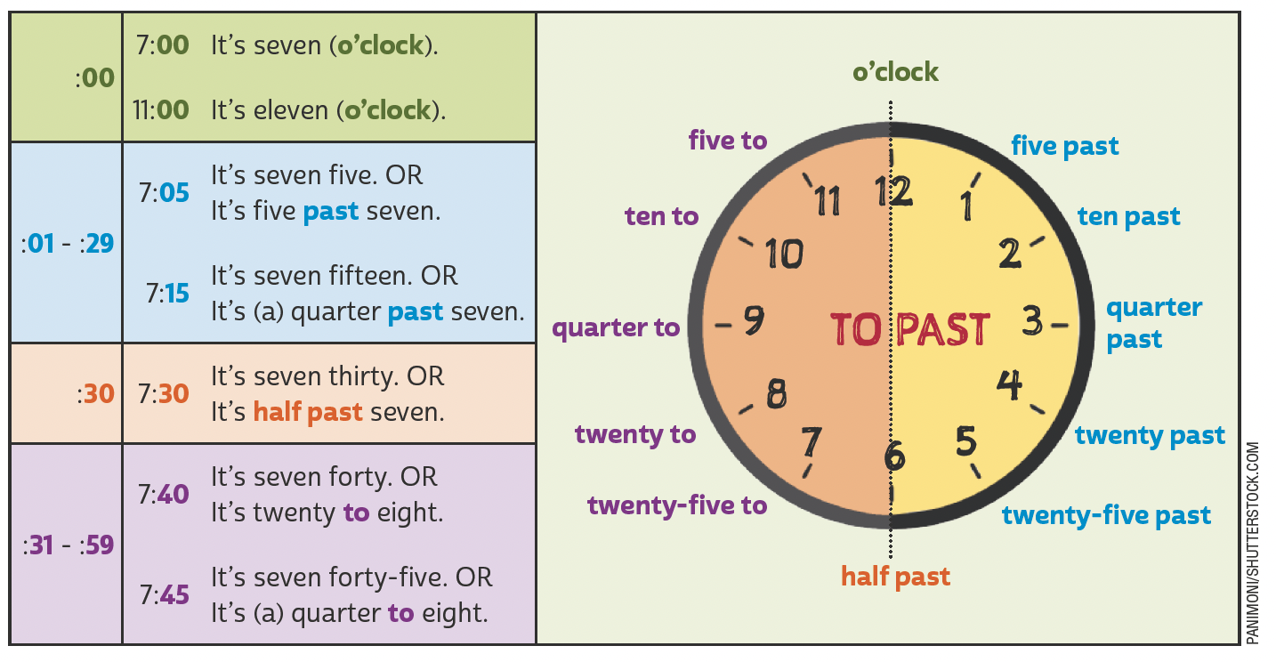
VOCABULARY CORNER
Unit 8: telling the time

Slide 15
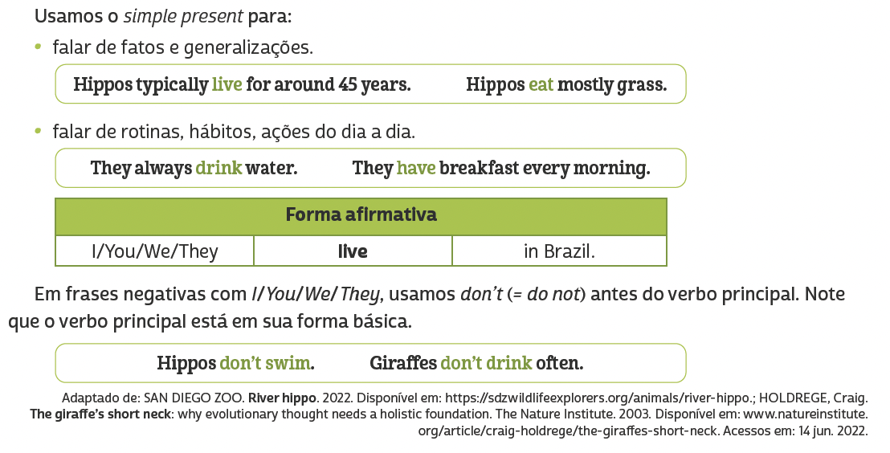
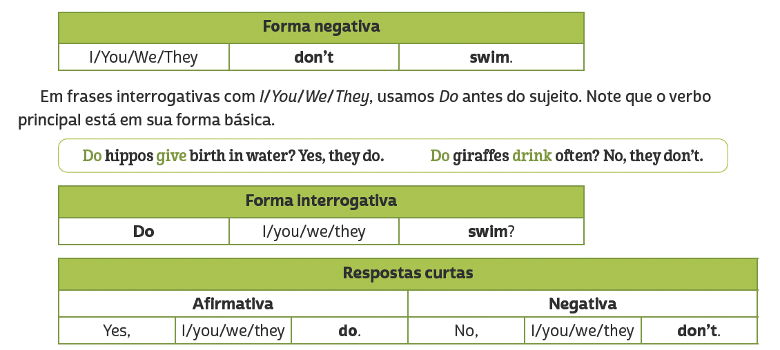
LANGUAGE REFERENCE
Unit 8: simple present (i/you/we/they)

Slide 16
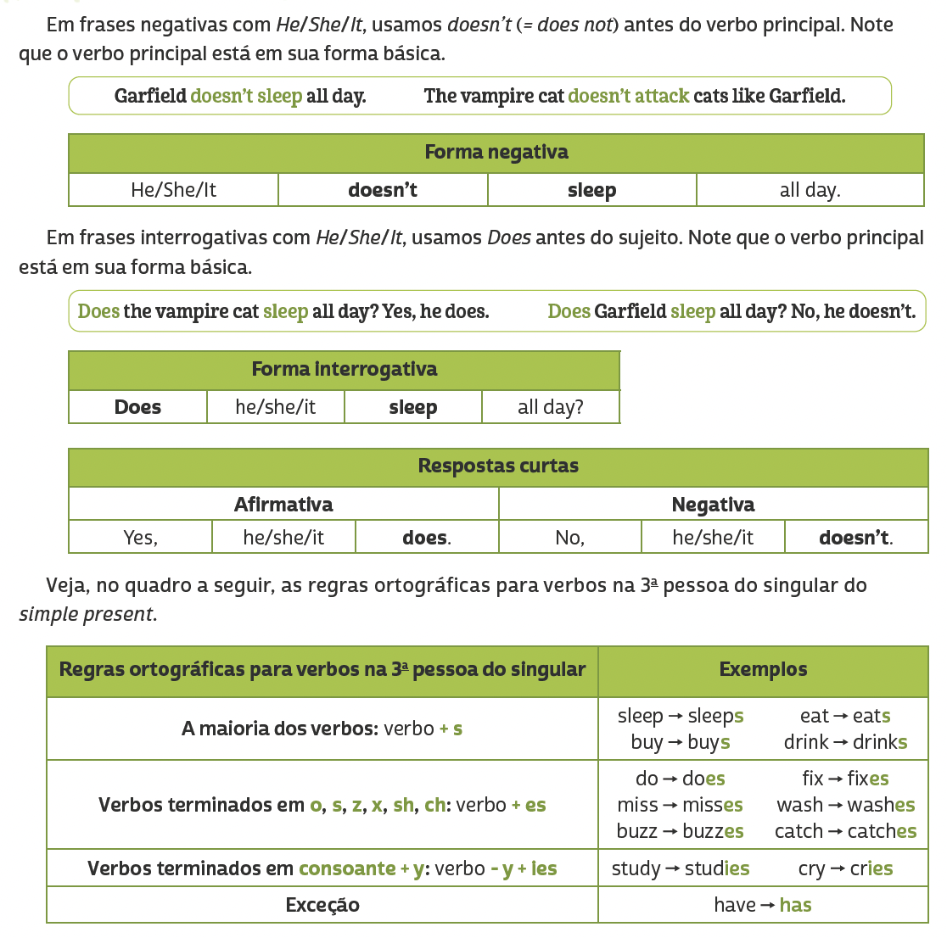
LANGUAGE REFERENCE
Unit 8: simple present (HE/SHE/IT)

