Slide 1
Língua inglesa
CONJUNTO 1
6º ano

Slide 2
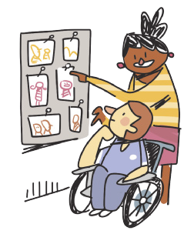
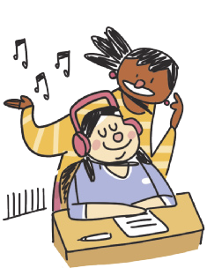
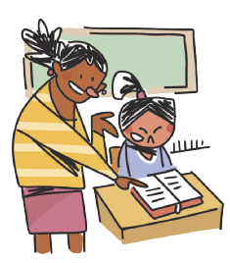
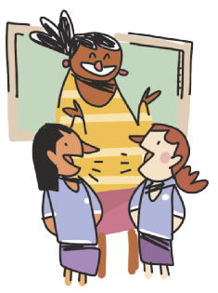
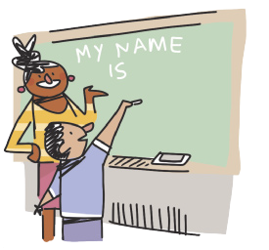
CLASSROOM LANGUAGE
WORK in groups.
LOOK at the photos.
READ the text.
LISTEN to the song.
ILUSTRAÇÕES: GALVÃO BERTAZZI
WRITE your name on the board.
TALK to your classmate.

Slide 3
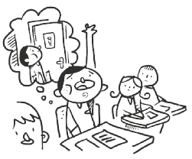
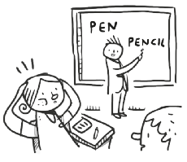
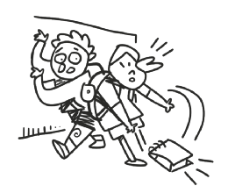
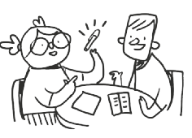
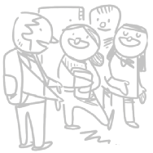
CLASSROOM LANGUAGE
May I go to the toilet?
I don’t understand.
I’m sorry.
How do you say “caneta” in English?
Excuse me.
ILUSTRAÇÕES: GALVÃO BERTAZZI

Slide 4
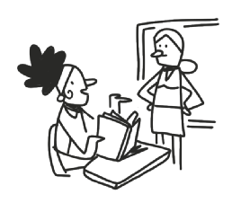
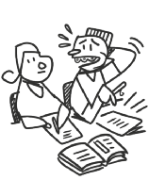
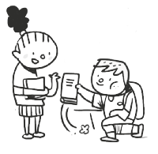
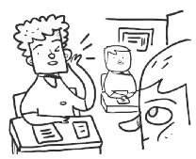
CLASSROOM LANGUAGE
What page?
Can you help me, please?
Thank you.
Can you repeat that, please?
ILUSTRAÇÕES: GALVÃO BERTAZZI

Slide 5
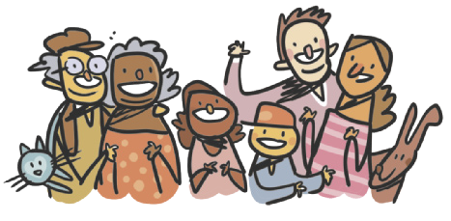
UNIT 4
What is a family?
Who is a family?
One and another makes two is a family!
Baby and father and mother: a family!
Parents and sister and brother: a family!
All kinds of people can make up a family
All kinds of mixtures can make up a family
What is a family?
Who is a family?
The children that lived in a shoe is a family!
A pair like a kanga and roo is a family!
A calf and a cow that go moo is a family!
All kinds of creatures can make up a family
All kinds of numbers can make up a Family
What is a family?
Who is a family?
Either a lot or a few is a family;
But whether there’s ten or there’s
two in your family,
All of your family plus you is a family!
ILUSTRAÇÕES: GALVÃO BERTAZZI
TIP
Note que, em poemas,
a linguagem é usada de
forma criativa.
HOBERMAN, Mary Ann. Fathers, mothers, sisters, brothers: a collection of family poems. Nova York: Hachette Book Group Inc., 2001. p. 3.

Slide 6
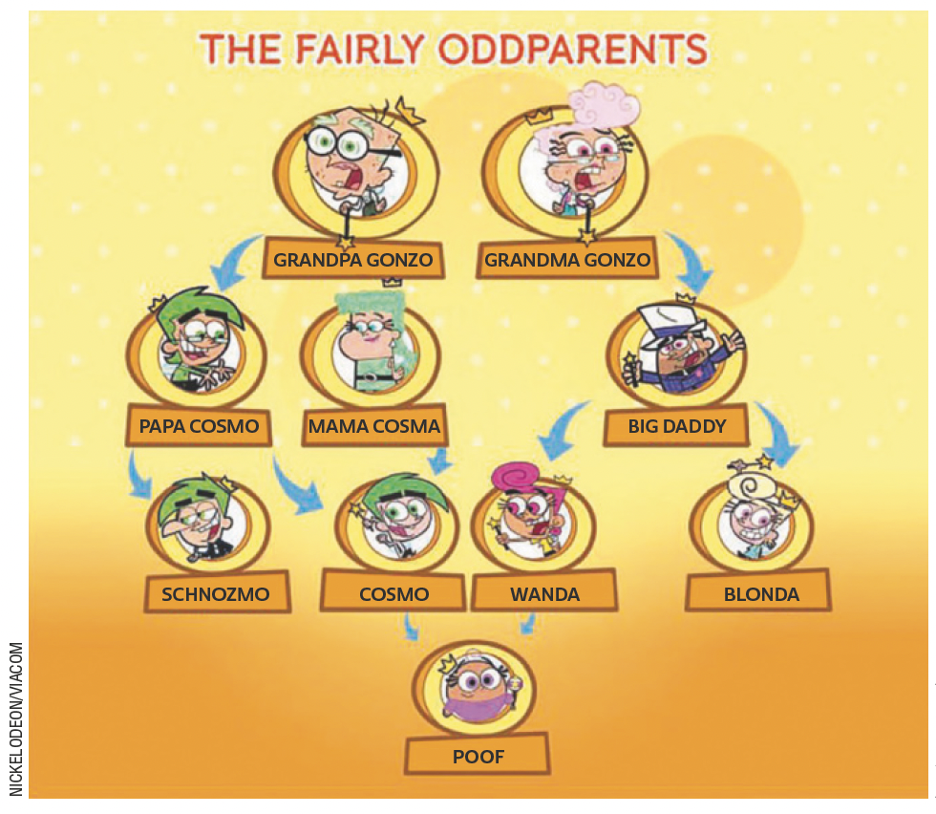
UNIT 4
LANGUAGE NOTE
dad (informal) = father
mom (informal) = mother
grandpa (informal) = grandfather
grandma (informal) = grandmother
Adaptado de: CREEK, Jeremy. Cosma-Fairywinkle family. Fairly Odd Parents Wiki. 2022. Disponível em: https://fairlyoddparents.fandom.com/wiki/Cosma-Fairywinkle_family. Acesso em: 30 maio 2022.

Slide 7
UNIT 4
parents
grandparents
children
mother
grandmother
sister
daughter
granddaughter
aunt
niece
father
grandfather
brother
son
grandson
uncle
nephew
Family members
TIP
O uso de cores é uma
estratégia que pode ajudar
você a organizar e fixar o
vocabulário.

Slide 8
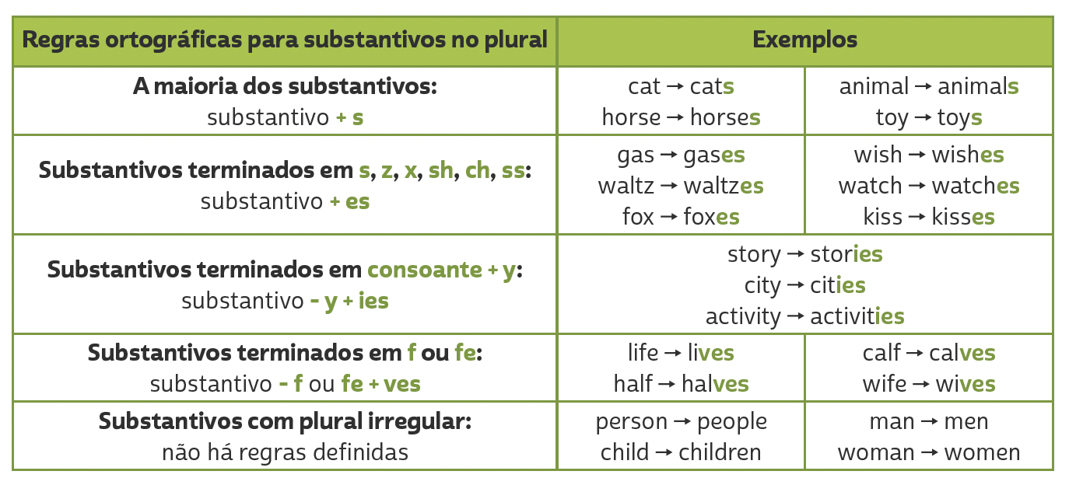
Unit 4
PLURALS

Slide 9
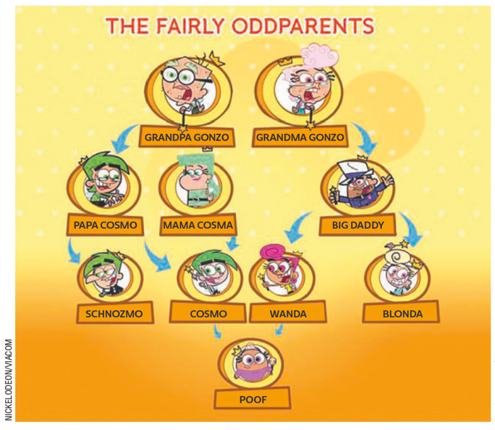
UNIT 4
Adaptado de: CREEK, Jeremy. Cosma-Fairywinkle family. Fairly Odd Parents Wiki. 2022. Disponível em: https://fairlyoddparents.fandom.com/wiki/Cosma-Fairywinkle_family. Acesso em: 30 maio 2022.
Genitive case ('s)
Who’s Papa Cosmo?
He is Cosmo’s father. (= the father of Cosmo)
b. Who’s Mama Cosma?
She is Cosmo’s mother. (= the mother of Cosmo)
c. Who are Grandpa Gonzo and Grandma Gonzo?
They are Cosmo’s grandparents. (= the grandparents of Cosmo)
TIP
Usamos o genitive case ('s) para indicar posse. O termo usado antes de 's se refere a que ou quem possui e o termo usado após 's se refere ao elemento possuído.

Slide 10
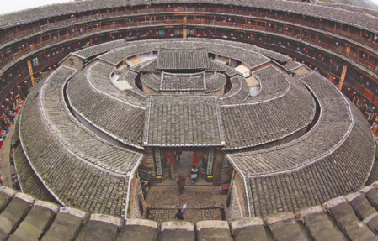
UNIT 5
COZYTA/SHUTTERSTOCK.COM
China
Living Together in a Circle
Deep in the mountains, there is a round building called a tulou. It is surrounded by a thick dirt wall. It is in the Fujian province of China. There are about three hundred people living in this tulou. It is very lively inside.
The tulou has four floors. There are four communal staircases, and more than 200 rooms of about the same size. On the first floor, there are kitchens all in a row. The second floor has warehouses, where the harvest and the farm tools are kept. The long hall is where the children play. The third and fourth floors have bedrooms that are also used for study. Parents and children share one room.
TIP
Não se preocupe em compreender todas as palavras de um texto. Nem sempre isso é necessário para você atingir seus
objetivos de leitura.
Adaptado de: KOMATSU, Yoshio. Wonderful houses around the world. California: Shelter Publications, 2004. p. 6, 8.

Slide 11
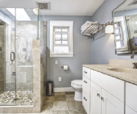
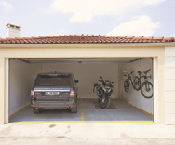
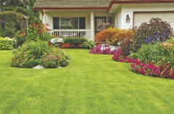
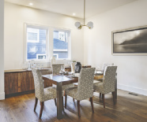
VOCABULARY CORNER
ERKANATBAS/
SHUTTERSTOCK.COM
bathroom
garage
FOTOCRAFT/
SHUTTERSTOCK.COM
Unit 5: PARTS OF THE HOUSE
bedroom
garden
dining room

Slide 12
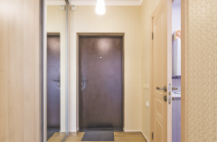
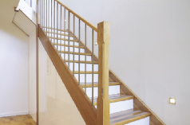
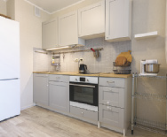
VOCABULARY CORNER
MADHOURSE/
SHUTTERSTOCK.COM
INSTA_PHOTOS/
SHUTTERSTOCK.COM
hall
stairs
MADHOURSE/
SHUTTERSTOCK.COM
JODIE JOHNSON/
SHUTTERSTOCK.COM
Unit 5: PARTS OF THE HOUSE
kitchen
study
ALEX GORINS/
SHUTTERSTOCK.COM
living room

Slide 13
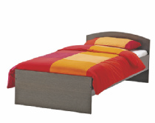
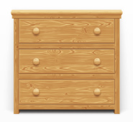
VOCABULARY CORNER
VOYSLA/
SHUTTERSTOCK.COM
DIMA MOROZ/
SHUTTERSTOCK.COM
bed
chest of drawers
Unit 5: FURNITURE
ANTHONY PAZ/
SHUTTERSTOCK.COM
PAIKONG/
SHUTTERSTOCK.COM
bookcase
couch/sofa
AV_PHOTO/
SHUTTERSTOCK.COM
chair

Slide 14
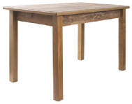
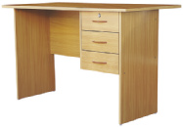
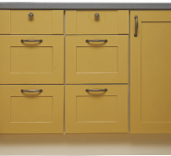
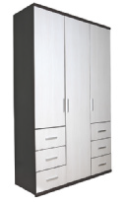
VOCABULARY CORNER
MARGO HARRISON/
SHUTTERSTOCK.COM
desk
table
Unit 5: FURNITURE
GRIGVOVAN/
SHUTTERSTOCK.COM
OKCAMERA/
SHUTTERSTOCK.COM
kitchen cabinet
wardrobe
STUDIOVIN/
SHUTTERSTOCK.COM
shelf

Slide 15
LANGUAGE REFERENCE
Unit 5:
THERE IS/THERE ARE

Slide 16
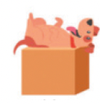
LANGUAGE REFERENCE
on
in
between
Unit 5: PREPOSITIONS OF PLACE
under
behind
next to
IEMONO//SHUTTERSTOCK.COM
above
in front of

