Slide 1
Língua inglesa
CONJUNTO 1
6º ano

Slide 2
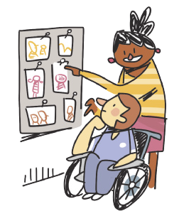
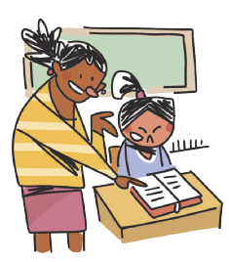
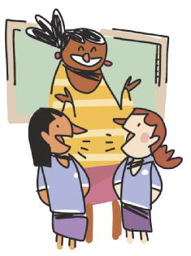
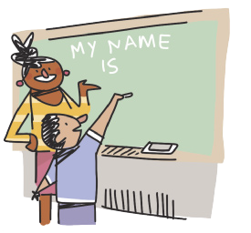
CLASSROOM LANGUAGE
WORK in groups.
LOOK at the photos.
READ the text.
LISTEN to the song.
ILUSTRAÇÕES: GALVÃO BERTAZZI
WRITE your name on the board.
TALK to your classmate.

Slide 3
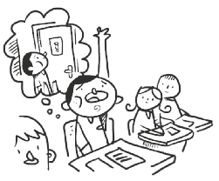
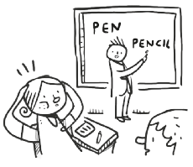
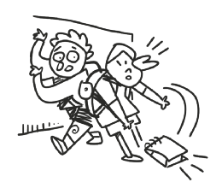
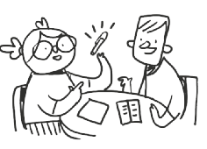
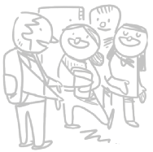
CLASSROOM LANGUAGE
May I go to the toilet?
I don’t understand.
I’m sorry.
How do you say “caneta” in English?
Excuse me.
ILUSTRAÇÕES: GALVÃO BERTAZZI

Slide 4
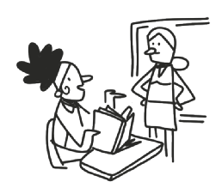
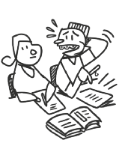
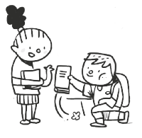
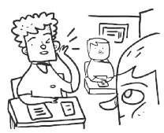
CLASSROOM LANGUAGE
What page?
Can you help me, please?
Thank you.
Can you repeat that, please?
ILUSTRAÇÕES: GALVÃO BERTAZZI

Slide 5
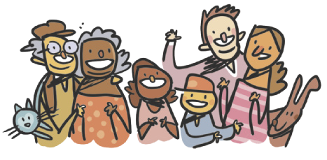
UNIT 4
What is a family?
Who is a family?
One and another makes two is a family!
Baby and father and mother: a family!
Parents and sister and brother: a family!
All kinds of people can make up a family
All kinds of mixtures can make up a family
What is a family?
Who is a family?
The children that lived in a shoe is a family!
A pair like a kanga and roo is a family!
A calf and a cow that go moo is a family!
All kinds of creatures can make up a family
All kinds of numbers can make up a Family
What is a family?
Who is a family?
Either a lot or a few is a family;
But whether there’s ten or there’s
two in your family,
All of your family plus you is a family!
ILUSTRAÇÕES: GALVÃO BERTAZZI
TIP
Note que, em poemas,
a linguagem é usada de
forma criativa.
HOBERMAN, Mary Ann. Fathers, mothers, sisters, brothers: a collection of family poems. Nova York: Hachette Book Group Inc., 2001. p. 3.

Slide 6
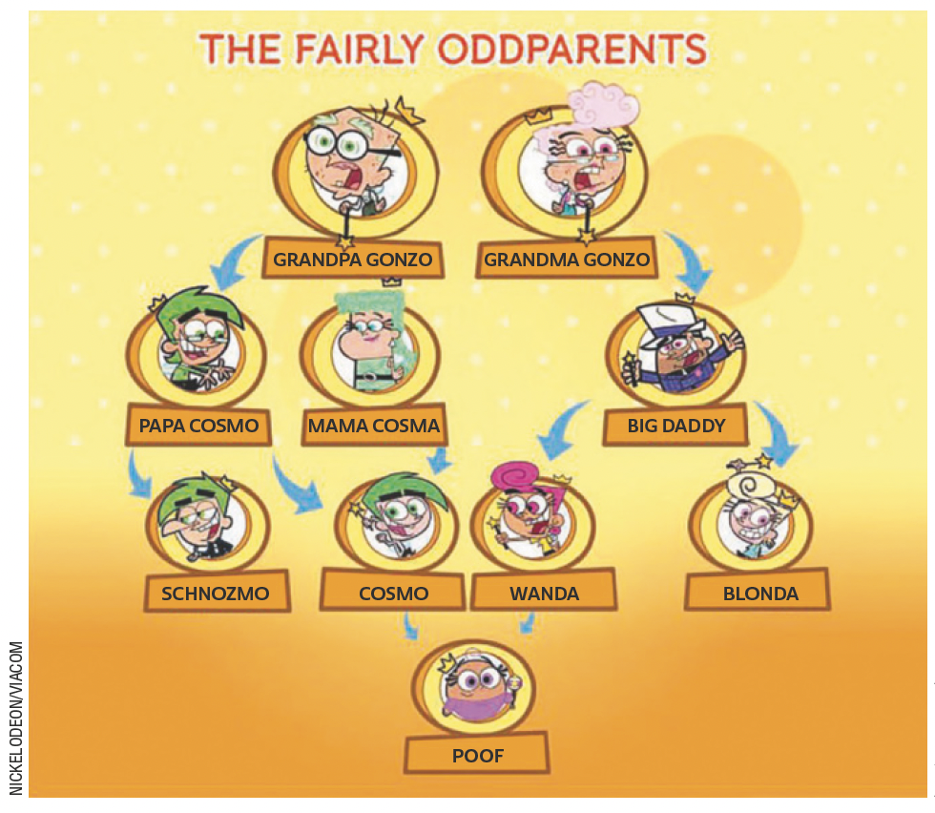
UNIT 4
LANGUAGE NOTE
dad (informal) = father
mom (informal) = mother
grandpa (informal) = grandfather
grandma (informal) = grandmother
Adaptado de: CREEK, Jeremy. Cosma-Fairywinkle family. Fairly Odd Parents Wiki. 2022. Disponível em: https://fairlyoddparents.fandom.com/wiki/Cosma-Fairywinkle_family. Acesso em: 30 maio 2022.

Slide 7
UNIT 4
parents
grandparents
children
mother
grandmother
sister
daughter
granddaughter
aunt
niece
father
grandfather
brother
son
grandson
uncle
nephew
Family members
TIP
O uso de cores é uma
estratégia que pode ajudar
você a organizar e fixar o
vocabulário.

Slide 8
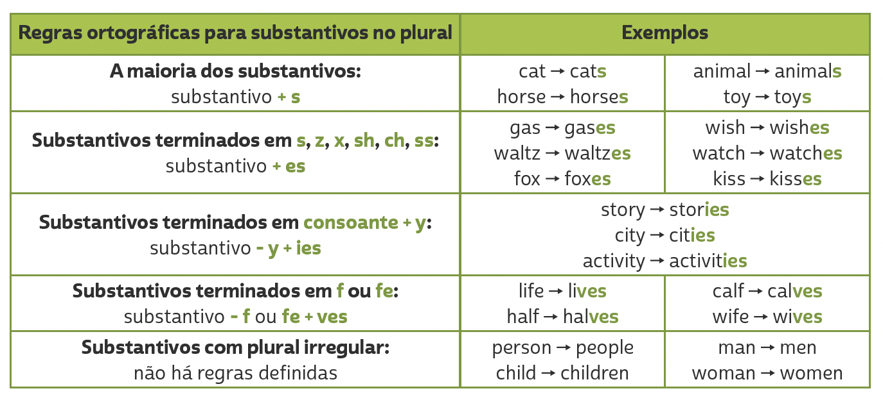
Unit 4
PLURALS

Slide 9
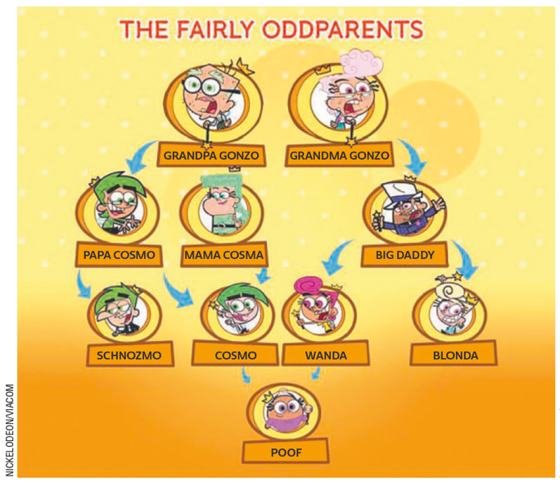
UNIT 4
Adaptado de: CREEK, Jeremy. Cosma-Fairywinkle family. Fairly Odd Parents Wiki. 2022. Disponível em: https://fairlyoddparents.fandom.com/wiki/Cosma-Fairywinkle_family. Acesso em: 30 maio 2022.
Genitive case ('s)
Who’s Papa Cosmo?
He is Cosmo’s father. (= the father of Cosmo)
b. Who’s Mama Cosma?
She is Cosmo’s mother. (= the mother of Cosmo)
c. Who are Grandpa Gonzo and Grandma Gonzo?
They are Cosmo’s grandparents. (= the grandparents of Cosmo)
TIP
Usamos o genitive case ('s) para indicar posse. O termo usado antes de 's se refere a que ou quem possui e o termo usado após 's se refere ao elemento possuído.

Slide 10
VOCABULARY CORNER
grandfather
grandmother
Unit 4: family members
aunt
father
mother
uncle
ME
cousin
brother
sister
ILUSTRAÇÕES: GALVÃO BERTAZZI

Slide 11
VOCABULARY CORNER
black
green
gray/ grey
purple
white
Unit 4: COLORS
blue
dark green
orange
red
yellow
brown
light green
pink

Slide 12
LANGUAGE REFERENCE
Unit 4:
PLURALS

Slide 13
LANGUAGE REFERENCE
Unit 4:
GENITIVE CASE (‘S)

