Slide 1
Língua inglesa
CONJUNTO 1
6º ano

Slide 2
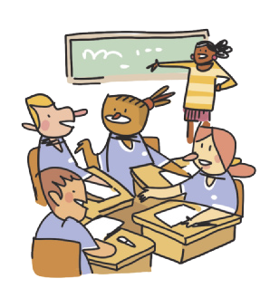
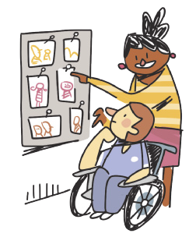
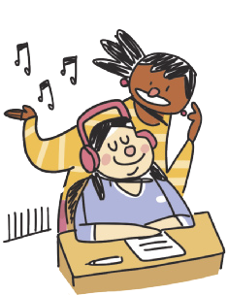
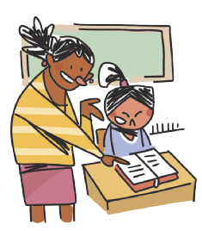
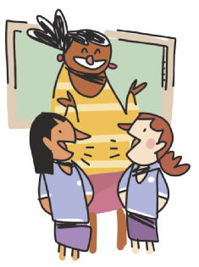
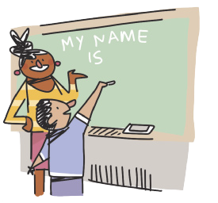
CLASSROOM LANGUAGE
WORK in groups.
LOOK at the photos.
READ the text.
LISTEN to the song.
ILUSTRAÇÕES: GALVÃO BERTAZZI
WRITE your name on the board.
TALK to your classmate.

Slide 3
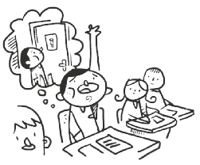
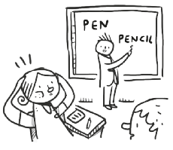
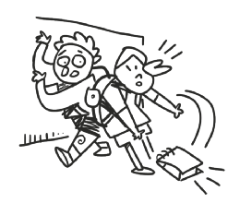
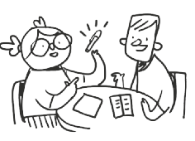
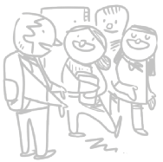
CLASSROOM LANGUAGE
May I go to the toilet?
I don’t understand.
I’m sorry.
How do you say “caneta” in English?
Excuse me.
ILUSTRAÇÕES: GALVÃO BERTAZZI

Slide 4
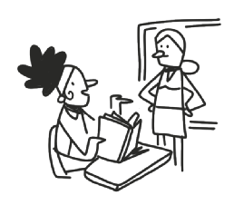
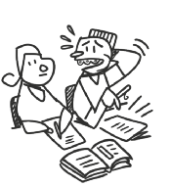
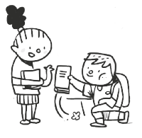
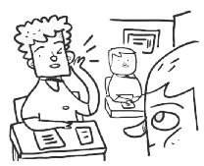
CLASSROOM LANGUAGE
What page?
Can you help me, please?
Thank you.
Can you repeat that, please?
ILUSTRAÇÕES: GALVÃO BERTAZZI

Slide 5
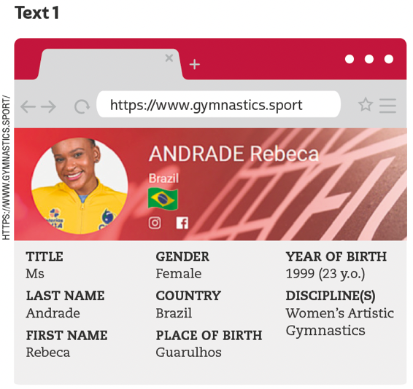
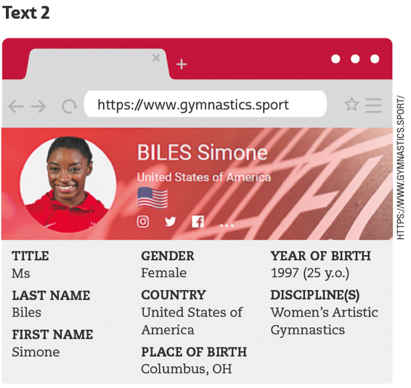
UNIT 3
TIP
Observe a estrutura do
texto, a fonte e as pistas
gráficas para formular
hipóteses sobre a finalidade dele.
FEDERATION INTERNATIONALE DE GYMNASTIQUE. Rebeca Andrade. 2021. Disponível em: www.gymnastics.sport/site/athletes/bio_detail.php?id=37359. Acesso em: 27 maio 2022.
FEDERATION INTERNATIONALE DE GYMNASTIQUE. Simone Biles. 2021. Disponível em: https://www.gymnastics.sport/site/athletes/bio_detail.php?id=38172. Acesso em: 27 maio 2022.
LANGUAGE NOTE
y.o. = years old

Slide 6
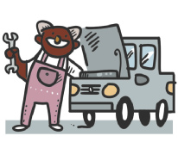
Unit 3
actor/actress
mechanic
teacher
occupations
PRONUNCIATION NOTE
Observe que, em inglês, o ch pode ser pronunciado de diferentes maneiras. Aqui, encontramos três palavras com ch (chef, mechanic, teacher) e, em cada uma, o ch representa um som diferente. Em chef, o ch representa o som de /ʃ/; em mechanic, o som de /k/; e, em teacher, o som de /tʃ/. Em português, o ch representa apenas um som, /ʃ/ como em “chefe”.
chef
police officer
vet
ILUSTRAÇÕES: GALVÃO BERTAZZI
doctor
student

Slide 7
Unit 3
countries
NATIONALITIES
Australia
Australian
Brazil
Brazilian
countries and nationalities
Canada
Canadian
TIP
Busque agrupar as palavras
pela terminação, como
Japanese, Portuguese.
France
French

Slide 8
Unit 3
countries
NATIONALITIES
Germany
German
India
Indian
countries and nationalities
Jamaica
Jamaican
Japan
Japanese

Slide 9
Unit 3
countries
NATIONALITIES
Portugal
Portuguese
South Africa
South African
countries and nationalities
Spain
Spanish
The United States
American

Slide 10
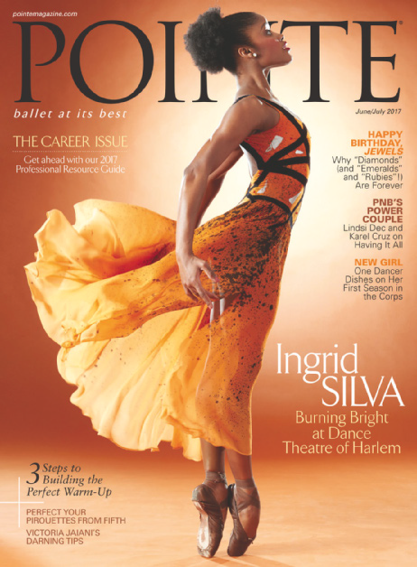
UNIT 3
THINK ABOUT IT!
Pointe é uma publicação internacional sobre balé. Na sua opinião, o que significa para Ingrid Silva estampar a capa dessa revista? Para você, como a trajetória profissional de Ingrid pode impactar a vida de jovens brasileiras/brasileiros que desejam se tornar bailarinas/ bailarinos?
POINTE MAGAZINE
POINTE. jun./jul. 2017. Disponível em: https://berksballettheatre.com/wp-content/uploads/2017/12/ingridjune-cover-753x1024.jpg. Acesso em: 27 maio 2022.

Slide 11
UNIT 3
I am not
He is not
She is not
It is not
We are not
You are not
You are not
They are not
= I’m not
= He isn't
= She isn't
= It isn't
= We aren't
= You aren't
= You aren't
= They aren't
VERB TO BE: NEGATIVE FORM
TIP
As formas verbais contraídas, tais como isn’t e aren’t, são usadas na linguagem coloquial, como em conversas entre amigos, tirinhas etc.

Slide 12
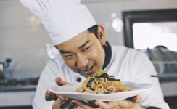
VOCABULARY CORNER
actor/actress
doctor
Unit 3: occupations
chef
engineer
dentist

Slide 13
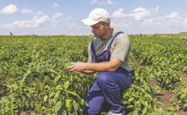
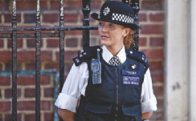
VOCABULARY CORNER
MONKEY BUSINESS IMAGES/
SHUTTERSTOCK.COM
farmer
nurse
Unit 3: occupations
PCRUCIATTI/
SHUTTERSTOCK.COM
lawyer
police officer
STUDIO 72/
SHUTTERSTOCK.COM
mechanic

Slide 14
VOCABULARY CORNER
RIDO/
SHUTTERSTOCK.COM
singer
student
TOMWANG/
© 123RF.COM
MONKEY BUSINESS IMAGES/
SHUTTERSTOCK.COM
Unit 3: occupations
vet
teacher
scientist

Slide 15
VOCABULARY CORNER
January
February
March
April
May
June
July
August
September
October
November
December
Unit 3: months of the year

Slide 16
VOCABULARY CORNER
countries
NATIONALITIES
Argentina
Argentine, Argentinean (Argentinian)
Australia
Australian
Unit 3: countries and nationalities
Brazil
Brazilian
TIP
Busque agrupar as palavras
pela terminação, como
Japanese, Portuguese.
Canada
Canadian

Slide 17
VOCABULARY CORNER
countries
NATIONALITIES
China
Chinese
England
English
Unit 3: countries and nationalities
France
French
Germany
German

Slide 18
VOCABULARY CORNER
countries
NATIONALITIES
India
Indian
Italy
Italian
Unit 3: countries and nationalities
Jamaica
Jamaican
Japan
Japanese

Slide 19
VOCABULARY CORNER
countries
NATIONALITIES
Mexico
Mexican
Nigeria
Nigerian
Unit 3: countries and nationalities
Portugal
Portuguese

Slide 20
VOCABULARY CORNER
countries
NATIONALITIES
South Africa
South African
Spain
Spanish
Unit 3: countries and nationalities
The United States
American

Slide 21
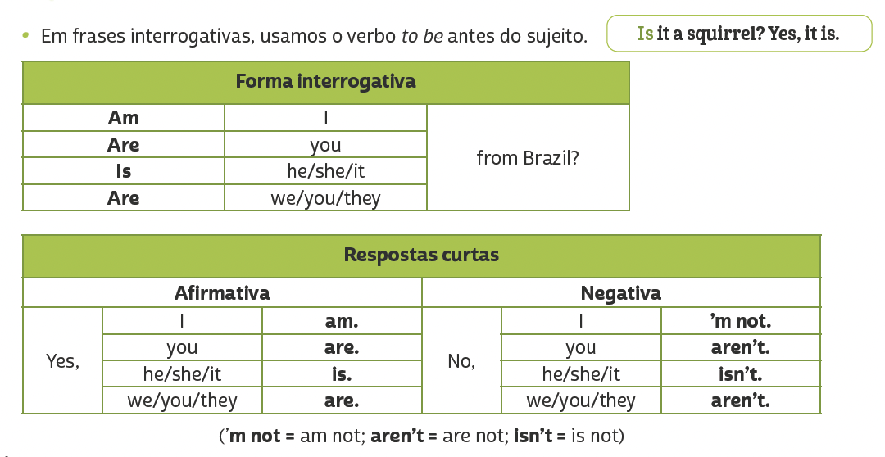
LANGUAGE REFERENCE
Unit 3:
Verb to be: negative and interrogative forms

