Slide 1
9º ano
CONJUNTO 2

Slide 2
Discourse Genres

Slide 3
Unit 5
Online Article
Recurrent structure | Headline, subheadings, introduction, body, conclusion, images, videos, links, etc.
Main themes | Any topics and subjects, including news, entertainment, lifestyle, science, technology, education, etc.
Social function | To inform, educate, entertain, or persuade readers who access the article online through a website or social media platform.
Target audience | People who use the internet and have an interest in the subject matter or who are looking for information online.
Who produces it? | Professional journalists, bloggers, writers, or content creators who produce articles for online publications.

Slide 4
Unit 5
PSA (Public Service Announcement)
Recurrent structure | Typically include a call-to-action and a brief explanation of the issue being addressed.
Main themes | Raising awareness about a particular issue, encouraging specific behaviors or actions, providing information to the public.
Social function | To educate the public about a particular issue or to encourage specific actions.
Target audience | They are intended to reach a broad audience.
Who produces it? | Advertising agencies, government agencies, nonprofit organizations, or individuals with a message to share.

Slide 5
Language Topics

Slide 6
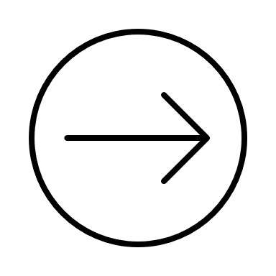
Unit 5
Connectors
• Connectors são usados para ligar frases e palavras. Eles expressam diferentes relações entre as ideias apresentadas.
Adição
and, also, or, furthermore, moreover, in addition, too,
besides, as well as
Contraste
but, although/even though, however, otherwise, yet
alternatively
Consequência
/resultado
as a result, thus, therefore, consequently

Slide 7
Adição
As customers we have to know our rights.
Furthermore, some institutions can clarify our questions when necessary.
Manufacturers need to provide complete information about their products. Moreover, stores have to make that information available to consumers in a clear manner.
Besides learning how to create a budget, I learned that spending less is always a good idea.
I control my spending as well as my earnings.

Slide 8
Contraste
Even though I don’t have a job, I save money whenever I can.
My mom opened a savings account for me. However, I have to make my own deposits.
I always make a list before going to the mall, otherwise I buy more things than I need.
If you have problems, talk to our manager. Alternatively, you can send us an e-mail.
I try to plan before I spend, yet it is not always possible.

