Slide 1
9º ano
CONJUNTO 2

Slide 2
Discourse Genres

Slide 3
Unit 4
News Article
Recurrent structure | Headline, lead or intro, body or text, quotes, conclusion.
Main themes | Current events, news, politics, social issues, business, science, entertainment, sports, etc.
Social function | To inform and update readers about current events and news stories.
Target audience | General public, news enthusiasts, professionals, academics.
Who produces it? | Journalists, reporters, editors, news agencies.

Slide 4
Unit 4
Podcast
Recurrent structure | Introduction, main topic, discussion, conclusion (planned or improvised).
Main themes | Varied (e.g. news, entertainment, education, health, etc.).
Social function | To inform, entertain, educate, inspire or share stories and perspectives with a listening audience.
Target audience | Anybody can listen to a podcast.
Who produces it? | Podcast hosts and producers, who are responsible for developing content and conducting interviews.

Slide 5
Language Topics

Slide 6
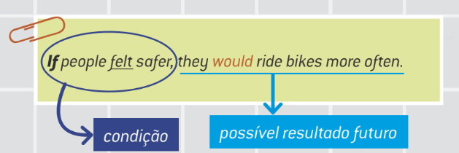
Unit 4
2nd Conditional
• A 2nd conditional descreve situações hipotéticas, imaginadas e improváveis, mas possíveis de acontecer se uma condição for atendida.

Slide 7
• Usamos vírgula após a oração com if.
If + simple past + would/wouldn’t (mais comum)
If there weren’t so many vehicles on the street, there would be less pollution.
If + simple past + could/might
If I woke up earlier, I could ride my bike to school.

Slide 8
• Quando a posição das orações está invertida, não precisamos da vírgula.
We would be happier and healthier if we spent less time in traffic jams.

