Slide 1
9º ano
CONJUNTO 2

Slide 2
Discourse Genres

Slide 3
Unit 3
Environmental Quiz
Recurrent structure | Title, introduction, multiple-choice questions, answers, explanations.
Main themes | Environment, sustainability, conservation, ecology.
Social function | To test readers' knowledge about environmental issues, promote awareness and interest in environmental topics
Target audience | Environmental enthusiasts, students, educators, the general public.
Who produces it? | Environmental organizations, educators, publishers, individuals passionate about the environment.

Slide 4
Unit 3
Spoken Word Poem
Recurrent structure | Repetition, rhyme, and rhythm. They may also include elements of storytelling and personal experience.
Main themes | Identity, social justice, love and relationships, mental health, etc.
Social function | To serve as a form of self-expression and catharsis for the performer, as well as a way to connect with and inspire the audience.
Target audience | Typically performed live by the poet themselves, although they can also be recorded and shared online.
Who produces it? | A poet.

Slide 5
Language Topics

Slide 6
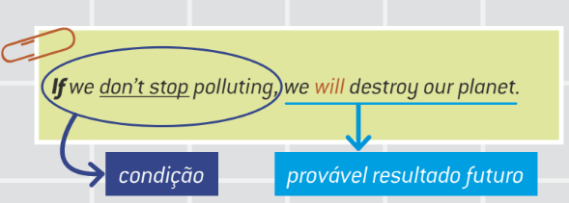
Unit 3
1st Conditional
• As orações condicionais apresentam situações imaginadas, que podem ser prováveis, improváveis ou impossíveis. A 1st conditional trata de situações prováveis de acontecer no futuro caso uma condição seja atendida.

Slide 7
• Usamos vírgula após a oração com if.
If + simple present + will/won’t (mais comum)
If we keep ignoring environmental problems, we won’ t be able to save the planet.
If + simple present + may/may not
If the sea level rises, some cities may disappear.

Slide 8
• Quando a posição das orações está invertida, a vírgula não é necessária.
A great number of animals and plants will go extinct if we don’t stop deforestation.

