Slide 1
9º ano
CONJUNTO 2

Slide 2
Discourse Genres

Slide 3
Unit 1
Ad
Recurrent structure | Headline, product/service description, features/benefits, brand, call to action.
Main themes | Persuasion, marketing, sales, promotion, products.
Social function | To persuade potential customers to buy a product or service, create brand awareness, generate leads, etc.
Target audience | Anyone who comes across the advertisement.
Who produces it? | Copywriters, marketing professionals, and advertising agencies.

Slide 4
Unit 1
Talk on Healthy Eating
Recurrent structure | Oral introduction, body, and conclusion.
Main themes | Nutrition, health, wellness, diet, food.
Social function | To educate, inform, and promote healthy eating habits.
Target audience | People interested in learning about healthy eating and nutrition.
Who produces it? | Health professionals, nutritionists, chefs, or individuals with experience in healthy eating and nutrition.

Slide 5
Language Topics

Slide 6
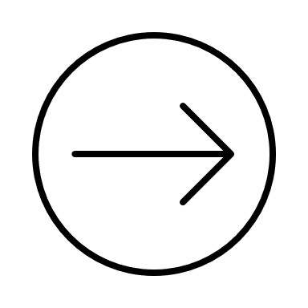
Unit 1
Modal Auxiliary Verbs
• Expressam ideia de habilidade, recomendação, necessidade, obrigação, probabilidade ou proibição.
• Possuem uma única forma para todas as pessoas.
• São usados antes do infinitivo (sem to) de outros verbos.
• Não possuem forma infinitiva (não são precedidos do to)

Slide 7
Can/Could
• Usados para falar de habilidades, pedir e dar permissão, fazer solicitações ou oferecer algo.
Afirmativa
I can swim very well.
Negativa
I can’t/cannot cook very well.
Interrogativa
Can you play a musical instrument?

Slide 8
• Could é a forma no passado do can, mas também é usado para pedir permissão ou fazer solicitação no presente de uma maneira mais educada e formal que can.
I couldn’t drink milk when I was a child. I was allergic. (passado)
Could you close the window, please? (pedido formal)

Slide 9
May/Might
• Expressam probabilidade (might pode expressar probabilidade menor que may).
She may prepare some veggies food for dinner.
• Também podem ser usados para pedir permissão ou fazer solicitação (formal).
May I use the bathroom?
• Negativa: may not e might not.
I might not eat at home tonight.

Slide 10
Should
• Usado para fazer uma recomendação ou dar um conselho.
You should eat more salad and fruit.
• Negativa: should not ou shouldn’t.
People shouldn’t eat hamburgers every day.

Slide 11
Must/Have to
• Expressam obrigação (must) ou forte necessidade (have to).
• Have to necessita do to antes do verbo principal.
People who have diabetes must follow a strict diet.
You have to sleep at least 8 hours per night to keep healthy.

Slide 12
Mustn’t/Not Have to
• Mustn’t expressa ideia de proibição.
I mustn’t eat strawberries because I’m allergic to them.
• Don’t have to é usado para indicar algo que não é necessário.
I don’t have to go on a strict diet.

