Slide 1
7º ano
CONJUNTO 2

Slide 2
Discourse Genres

Slide 3
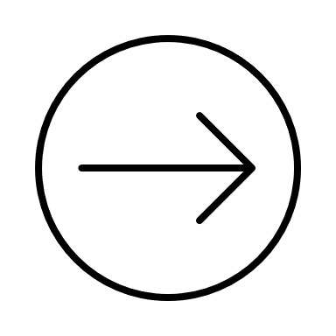
Unit 2
Q&A posts | Q & A Posts
Recurrent structure | A question (or multiple questions) posed by the reader or user, followed by an answer from the author or an expert on the topic.
Main themes | Providing helpful information, solving problems or addressing concerns of the readers, and sharing knowledge on a particular topic.
Social function | To provide a platform for individuals to ask questions and receive answers from knowledgeable sources and build a sense of community.

Slide 4
Target audience | People who have questions or concerns about a particular topic and are looking for answers or guidance.
Who produces it? | Experts or authorities on the topic or by individuals who have personal experience or knowledge on the subject matter. It could also be written by community managers, bloggers, etc.

Slide 5
Unit 2
Accounts: Childhood Memories
Recurrent structure | Narrative, chronological
Main themes | Personal experiences, childhood memories
Social function | Entertainment, emotional connection
Target audience | Usually intended for a general audience, but can be for a specific audience.
Who produces it? | Usually the person who experienced the memories or a biographer/ghostwriter.

Slide 6
Language Topics

Slide 7
Unit 2
Simple Past: verb to be
Usamos o simple past para falar de ações ou eventos que ocorreram no passado. Há duas formas do verbo to be: was e were.
Afirmativa
I was You were She was He was It was We were They were | In 2024, I was in the 7th grade.

Slide 8
Negativa
I was not (wasn’t) You were not (weren’t) She was not (wasn’t) He was not (wasn’t) It was not (wasn’t) We were not (weren’t) They were not (weren’t) | My father wasn’t in Salvador when I was a kid.

Slide 9
Interrogativa
Was I Were you Was she Was he Was it Were we Were they | Were your friends from 6th grade funny?
Respostas curtas — afirmativa e negativa
Yes, they were. / No, they weren’t.

Slide 10
Unit 2
Can/Could — ability
Usamos can e could para falar de habilidades ou capacidades. Eles são chamados de verbos modais. Can e can’t referem-se ao tempo presente. Já could e couldn’t são usados para falar de um tempo passado.

